Slide 1
Is it Time for a Change?
Potential modifications to the Inshore Fisheries Trammel Net and Electrofishing Surveys

Slide 2
Inshore Fisheries Section – Since 1985
Investigate fish and shark populations in the estuaries and nearshore coastal waters of South Carolina
Learn about the life history characteristics and population dynamics of select species
Biological data, coupled with population level monitoring data provided by long-term surveys, provides resource managers with sound information to protect South Carolina’s fish resources
Notes:
Staff of the Inshore Fisheries Research section conducts investigations on fish and shark populations in the estuaries and nearshore coastal waters of South Carolina. We have been investigating various aspects of the life history of estuarine fishes since 1985. Our goal is to learn about the life history characteristics and population dynamics of select species to accurately predict the impact of fishing pressure on them. Our efforts supply comprehensive biological data on many aspects of the lives of fishes such as age and growth, diet, genetics, reproductive dynamics, recruitment, parasite loads, and mortality. The compilation of the biological data, coupled with population level monitoring data provided by long-term surveys operated by the section, provides resource managers with sound information based on the best science available, to protect South Carolina’s fish resources for years to come.

Slide 3
Our Fishery-Independent Surveys
Notes:
Presently, we have five active fishery-independent monitoring programs that operate in coastal and estuarine systems throughout South Carolina. These programs target juveniles and adults of various species. Our surveys are essential for understanding changes in fish populations over time, as well as the natural and man-made forces that influence them

Slide 4
Our Fishery-Independent Surveys
Trammel Net Survey
RecFIN (NOAA)
SRFAC-Inshore (License Sales)
Notes:
Trammel Net Survey – The 1st of these, which occurs year-round, is our trammel net survey. It is one of the longest running inshore surveys along the east coast. The trammel net survey operates (since 2009) in all major estuaries along the coast year-round, targeting recreationally important species that use salt marsh habitat such as Red Drum, Spotted Seatrout, Southern Flounder, Sheepshead, and Black Drum. The major funding sources for this survey is our NOAA RecFIN funds and our SRFAC Inshore Fisheries Funds

Slide 5
Our Fishery-Independent Surveys
Electrofishing Survey
RecFIN (NOAA)
SRFAC-Inshore (License Sales)
Notes:
Electrofishing Survey – Our 2nd year-round survey is our electrofishing survey, which covers five upper-estuarine areas across the state. This survey targets young-of-year and sub-adult Red Drum that are found in freshwater areas of the estuary, as well as other important species such as Southern Flounder, Striped Bass, and American Eel. As with the trammel net survey, the major funding sources for this survey is RecFIN and SRFAC

Slide 6
Our Fishery-Independent Surveys
Adult Red Drum and Shark Longline Survey
SEAMAP-SA (NOAA)
Red Drum License Plate
SRFAC-Inshore (License Sales)
Notes:
Adult Red Drum and Shark Longline Survey – Now we transition to our seasonal surveys, the 1st of which is our adult red drum and shark longline survey. Though the forerunner of this survey began in the 1990s, the survey was re-designed to its current form in 2007. The survey is performed during the fall (mid-August to early-December) each year to monitor adult Red Drum and coastal shark populations. This survey, is funded by several different funding sources, including federal SEAMAP-SA funding, SRFAC funding, and funding from our Red Drum License plate sales.

Slide 7
Our Fishery-Independent Surveys
COASTSPAN / IJ Survey
COASTSPAN (NOAA)
Interjurisdictional Funds (NOAA)
Notes:
COASTSPAN / IJ Survey – Next, we have the seasonal Cooperative Atlantic States Shark Pupping and Nursery Survey, which began in 1998. This survey samples in three South Carolina estuaries: Bulls Bay, North Edisto River, and Saint Helena Sound, where it targets young-of-year sharks that use the estuaries as primary and secondary nursery grounds. The main goal of the survey is to determine the relative abundance, distribution and migration of the sharks using these areas through longline, drumline, and gillnet sampling. This survey is seasonal in nature, operating from late-April to early-August annually

Slide 8
Our Fishery-Independent Surveys
Estuarine Trawl Survey
SRFAC-Crustacean (License Sales)
SRFAC-Inshore (License Sales)
Notes:
Estuarine Trawl Survey – The Crustacean Research Section of SCDNR performs a trawl survey in South Carolina waters to monitor populations of commercially important shrimps and crabs. Beginning in 2011, bycatch of fish that occur via the trawl, at select stations, have been counted and measured monthly, contributing valuable information on small juvenile fishes and several species, such as weakfish, that are rarely encountered by our other surveys. Though annual in nature, this survey has much less sampling effort than our trammel net and electrofishing surveys.

Slide 9
Core funds aren’t increasing as quickly as costs are!!!
To be sustainable in the future, we need to look at options to reduce field efforts while minimizing impacts on long term data trends

Slide 10
Adult Red Drum and Shark Longline Survey
Seasonal surveys & limited effort year-round surveys?
COASTSPAN Survey
Estuarine Trawl Survey
Where can we reduce effort?
Trammel Net Survey
High effort, year-round surveys?
Electrofishing Survey
Notes:
So, the question becomes, where can we reduce effort?
One option is to reduce effort in seasonal surveys and limited effort year round surveys. This would mean reducing effort associated with the adult red drum and shark longline survey, the COASTSPAN Survey, or the Estuarine Trawl Survey.
Other option is to reduce effort in our high effort, year-round surveys. This would mean reducing effort in the trammel net and electrofishing surveys.
In my mind, we have the most scope for decreasing effort, without negatively impacting our ability to detect trends in relative abundance via reductions in effort associated with the trammel net, and to a somewhat lesser extent, the electrofishing survey. I would not want to see us cut our seasonal surveys or our efforts with regards to the estuarine trawl survey currently.

Slide 11
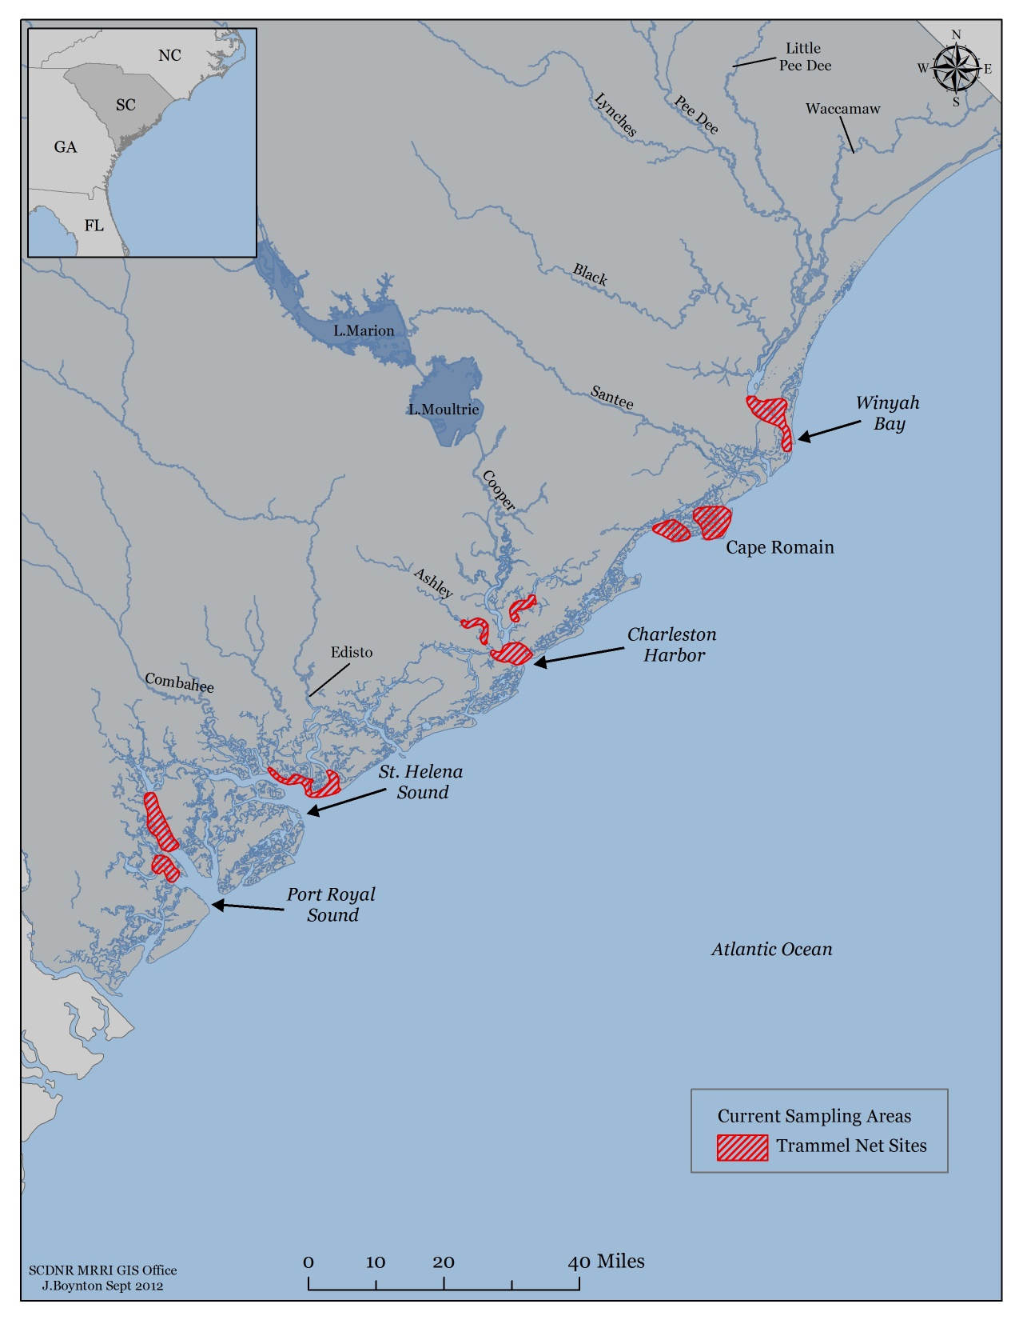
Trammel Net Survey – Current Effort
Strata
Monthly = 7 (AB, AR, CH, LW, MB, RH, WB)
Quarterly = 2 (CT, BR)
Field Days = 92
6 staff/field day
Staff Man Years
2.7 years – field only (40% of time)
4.1 years – lab/office only (60% of time)
Total Staff Time: 6.83 years
Notes:
Currently, inshore fisheries is sampling 9 different estuarine strata, 7 of which we have sampled monthly during all months of the year. These include all the strata from the ACE Basin in the South to Winyah Bay in the North. We are only sampling the two strata in Port Royal Sound quarterly, thus only 4 samples from these strata annually.
This equates to 92 field days, with each field day requiring 6 field staff.
If we convert these field days to staff many years required to run this survey, using average times it takes to complete a sampling day in each strata, this equates to 2.73 man years of field time. If we further assume that field time only represents 40% of the total time needed annually for survey related activities, we need an additional 4.10 man years of lab/office time.
Thus, in total, it takes almost 7 full time staff to only operate our trammel net survey.

Slide 12
Current Strata, quarterly sampling in PRS
11 Months
10 Months
9 Months
8 Months
Times Monthly Strata sampled?
7 Months
6 Months
5 Months
Merge Cape Romain (MB, RH) and PRS (CT, BR) strata; monthly sampling PRS
4 Months
Notes:
So, how do we reduce effort in the trammel net survey. The 1st question to answer, is do we maintain all of our current strata, and quarterly sampling in the Port Royal Sound, or…
do we consider merging strata, the most likely candidates being merging the two geographically near strata in Cape Romain (these were merged from 1994-1997) and the geographically near strata in Port Royal Sound, and conduct sampling at the same frequency across all strata.
Regardless of this decision, the next question is how frequently do we sample monthly strata, with plausible reductions ranging from 4 months to 11 months annually.
Given that the less frequently we sample strata the greater risk of not detecting important trends, sampling frequencies in excess of 6 times a year are likely preferable. We already know, based on >10 years of sampling in PRS, that quarterly sampling leads to much greater uncertainty in abundance trends.

Slide 13
Number: frequency “monthly” strata sampled per year
Status quo: PRS sampled quarterly, as current
Merge strata: merge Cape Romain & PRS strata
Notes:
When considering the frequency of sampling, an important consideration is how much of a reduction in field time one can expect under the different scenarios, which is what I’m showing here.
To orient you, in the x-axis label, the number represents the frequency of sampling a given “monthly” strata annually; the 2nd part of the label identifies how strata are treated, with the status quo representing maintaining the current 9 strata, with quarterly sampling in Port Royal Sound; Merge strata assumes that we would merge the two Port Royal Sound and Cape Romain strata and then treat all strata as “monthly” strata. As such, each strata would be sampled a set number of times annually.
Based on this, we might want to consider targeting a 20-40% reduction in field time annually for the trammel net survey.

Slide 14
Number: frequency “monthly” strata sampled per year
Status quo: PRS sampled quarterly, as current
Merge strata: merge Cape Romain & PRS strata
Notes:
Under this assumption, there are 3 different strata status quo scenarios and four different merged strata scenarios that will allow a 20-40% reduction in field time. Note, if we merge strata, we will be able to sample each individual strata more frequently.

Slide 15
All Months of the Year
January – December
What months should we conduct sampling?
February – December
(11 Months of the Year)
Certain Months of the Year?
March – December
(10 Months of the Year)
March – November
(9 Months of the Year
Notes:
The final question we need to ask ourselves is what months should we conduct sampling?
Should we continue to operate the trammel net survey during all months of the year?
Or should we only operate the trammel net survey during certain months of the year? If only certain months, what months? With the most likely months that could be dropped without significantly affecting our ability to detect trends being the winter months of December, January, and February. This is because these are the months when catches are generally the lightest, and…

Slide 16
Notes:
When we look at the 24 species encountered by the trammel net survey, for which we have averaged encountering >50 annually since the start of the survey, we see that none are encountered exclusively during the months of December, January, and February.
In fact for the species that we don’t really capture during all months of the year, if we sampled only from March-November we would expect roughly the same numbers of individuals encountered.

Slide 17
What would the impact of survey design changes to the trammel net survey have on our ability to track changes in species relative abundance?
Key factors to consider: 1) How does it affect our uncertainty and 2) Does the trend in abundance change?
Notes:
Now that I’ve laid out the questions, and some potential options, the question becomes how can we anticipate how survey design changes will affect our ability to track changes in individual species? Key factors to consider in this discussion is how would it affect our measures of uncertainty relative to annual abundance estimates and how would we expect the trend in abundance to change?

Slide 18
How investigated?
Inshore has been sampling 7 strata monthly
Earliest years, only a few of the strata existed
All strata existed since 2003 – added Winyah Bay
Notes:
To answer these questions, I used historical data available form 7 strata that we have been sampling monthly. That said, in the earliest years, only a few of the strata existed, but all strata have existed since 2003, when we added Winyah Bay

Slide 19
How investigated?
Inshore has been sampling 7 strata monthly
Re-calculated statewide abundance trends observed if had “only” sampled a subset of trips
Reduced frequency of sampling in a given strata
6-11 months a year
Only sampled a reduced portion of the year
February – December
March – December
March – November
Combination of reduced portion of the year and reduced sampling frequency
Notes:
Based on data from these 7 strata, I then re-sampled the available data to re-calculate historic statewide abundance trends as if I had “only” sampled a subset of trips.
To do this, I had a series of investigations where I reduced frequency of sampling in a given strata, with frequency ranging from 6 to 11 times a year.
I also asked the question, what would the relative abundance of a given species have looked like if I had only sampled during a reduced portion of the year, with the sampling season spanning one of three options: February-December, March-December, or March-November
Finally, I looked at all possible combinations of reduced portions of the year and reduced sampling frequency. For the reduced frequency of sampling in a given strata and combination investigations, I ran 1000 simulations for each possibility. Given we had the data to directly calculate what the abundance trend would have looked like if we had just sampled a reduced portion of the year, there was no need to simulated this effect, and I just re-calculated the relative abundance as if we had only sampled a subset of months.
You can think of these as being analogous to the option of…

Slide 20
Number: frequency “monthly” strata sampled per year
Status quo: PRS sampled quarterly, as current
Merge strata: merge Cape Romain & PRS strata
Notes:
Merging strata and reducing the sampling frequency of individual strata. Keeping in mind we were originally targeting a 20-40% reduction of sampling effort.

Slide 21
How investigated?
Inshore has been sampling 7 strata monthly
Re-calculated statewide abundance trends observed if had “only” sampled a subset of trips
Investigated the survey changes with respect to…
Individual Species
Relative abundance
Annual CV
Survey Median CV
Notes:
I then investigated these survey changes with respect to how it affected individual species, particularly how it affected apparent changes in relative abundance, annual CV, and across year median CV.

Slide 22
How investigated?
Inshore has been sampling 7 strata monthly
Re-calculated statewide abundance trends observed if had “only” sampled a subset of trips
Investigated the survey changes with respect to…
Individual Species
Overall Survey Uncertainty
Median Survey CV Across All Species
Median Survey CV Across Select Species
Notes:
I also wanted to look at the effects on the survey holistically, so I looked at how it affected overall survey uncertainty across all species and across select species of main interest to the inshore fisheries section.
Unfortunately, here I do not have enough time to go through all the results, so I’ll just focus on a few species and the effects on the survey overall.

Slide 23
How would it have affected our understanding of Red Drum relative abundance?

Slide 24
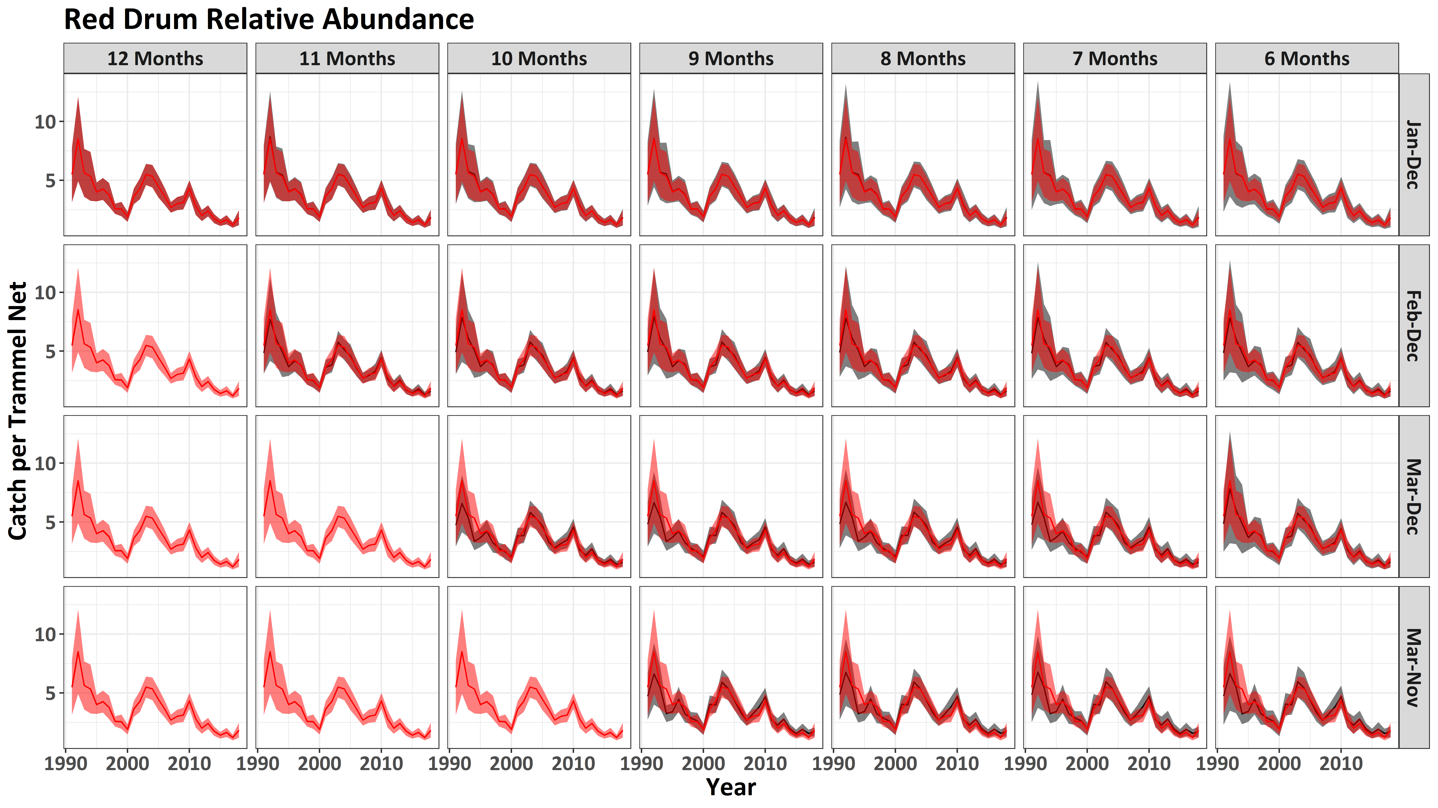
Notes:
Here I’m showing the effect on apparent Red Drum CPUE. To understand this plot, let me 1st orient you as you will see many of these during the remainder of the presentation. First, the y-axis is the catch of the species per trammel net and the x-axis is the survey year. The plot is arranged in panels, with vertical columns representing the sampling frequency, the number of months sampled annually, and the horizontal rows representing the sampling season, therefore the months available for sampling. Given this layout, the observed CPUE with 95% CI in the shaded region using all available data is shown in the top left panel. This “status quo” relative abundance is shown in all of the other panels so you can see the effect that reducing sampling frequency and sampling season has on relative abundance.
The area in the red box are the combinations that would provide somewhere between a 20-40% reduction in field efforts.
When we calculate the median nominal index (black line) and median 95% ci (gray shaded region), we do not really see much degradation relative to the original abundance index when we focus on the period since 2003 when all 7 strata were being fully sampled. We do see some degradation in the earliest years when we excluded March sampling, but this is likely more a result of having fewer strata being sampled during this period.
This relative insensitivity to survey design changes for Red Drum is likely the result of their abundance in the survey.

Slide 25
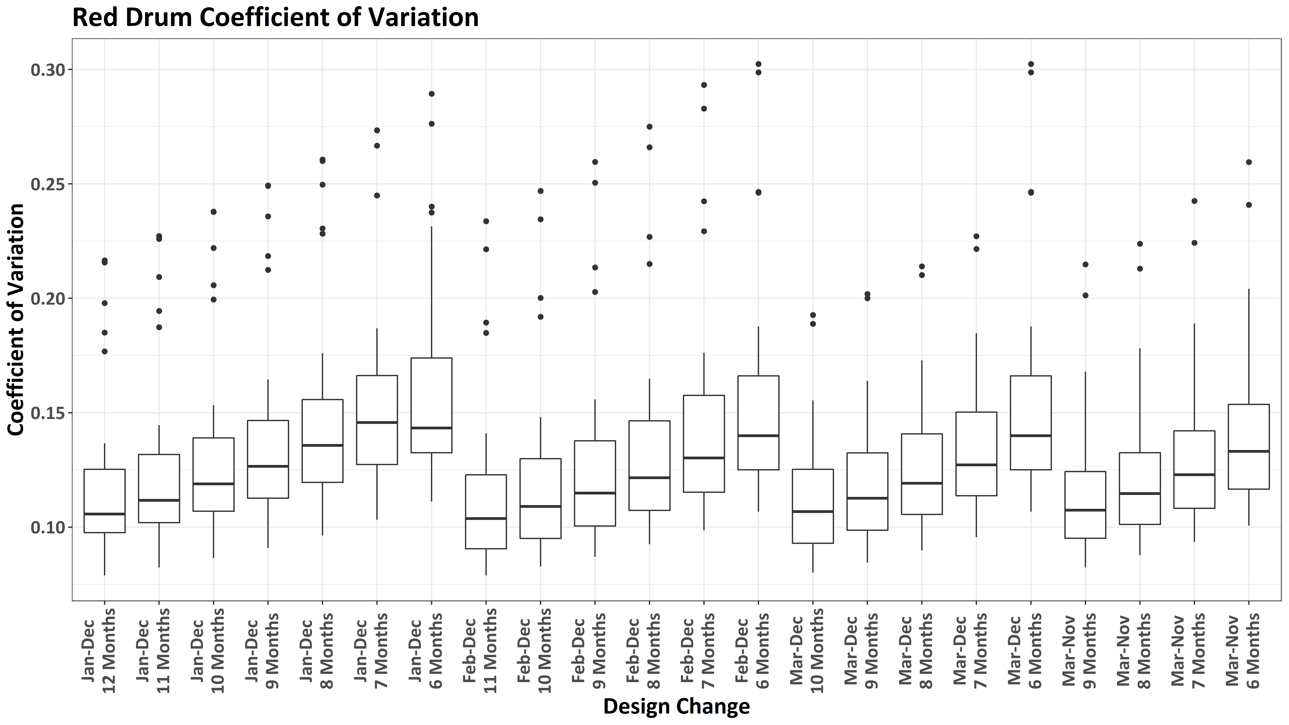
Notes:
This relative insensitivity of the nominal index to survey design changes for Red Drum is also apparent when we look at how the CV across all years of the survey changes under different scenarios. Here the y-axis is the coefficient of variation and the x-axis is the survey design characteristics, where the 1st part of the label corresponds to the sampling season and the 2nd part of the label corresponds to the frequency of sampling. The scenarios are grouped by sampling season. The boxes show the median (horizontal thick line) and interquartile range (top and bottom of the boxes) –in 50% of the years, the data fell in this range. The outliers, dots, are from the early years of the survey when fewer strata were being sampled.
Note, fishery-independent surveys with median CV’s <0.2 are generally considered robust surveys.
For red drum, this confirms what I said earlier – the nominal index is relatively insensitive to survey design changes, with expected median CVs always <0.2.

Slide 26
How would it have affected our understanding of Spotted Seatrout relative abundance?

Slide 27
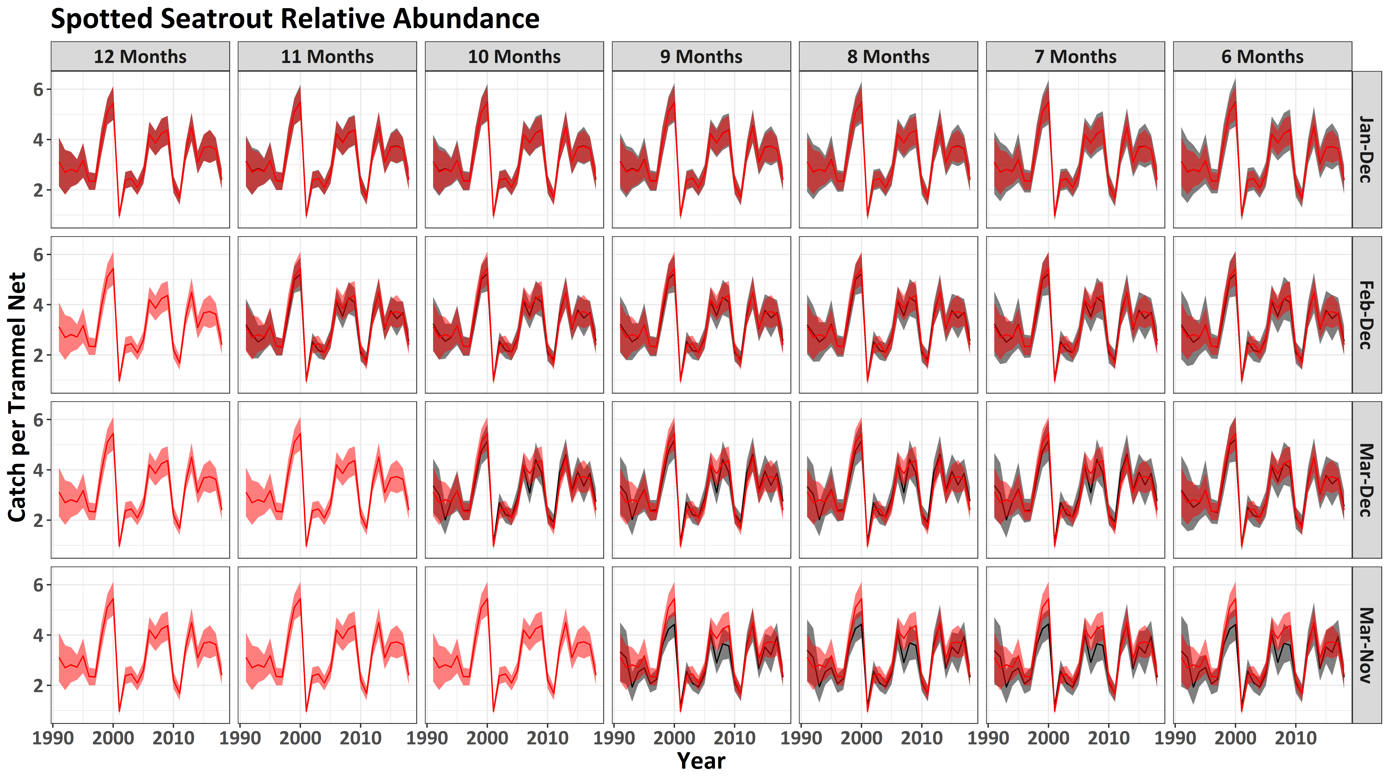
Notes:
As with red drum, when we calculate the median nominal index and 95% ci under different survey design changes, we do not really see much degradation relative to the original abundance index. Some exceptions do occur when we exclude the months of December, January, and February. I suspect this is because of the impact that winter temperatures can have on the relative abundance of spotted seatrout. In this case, we seem to see a bigger effect when we have periods of warmer winters.

Slide 28
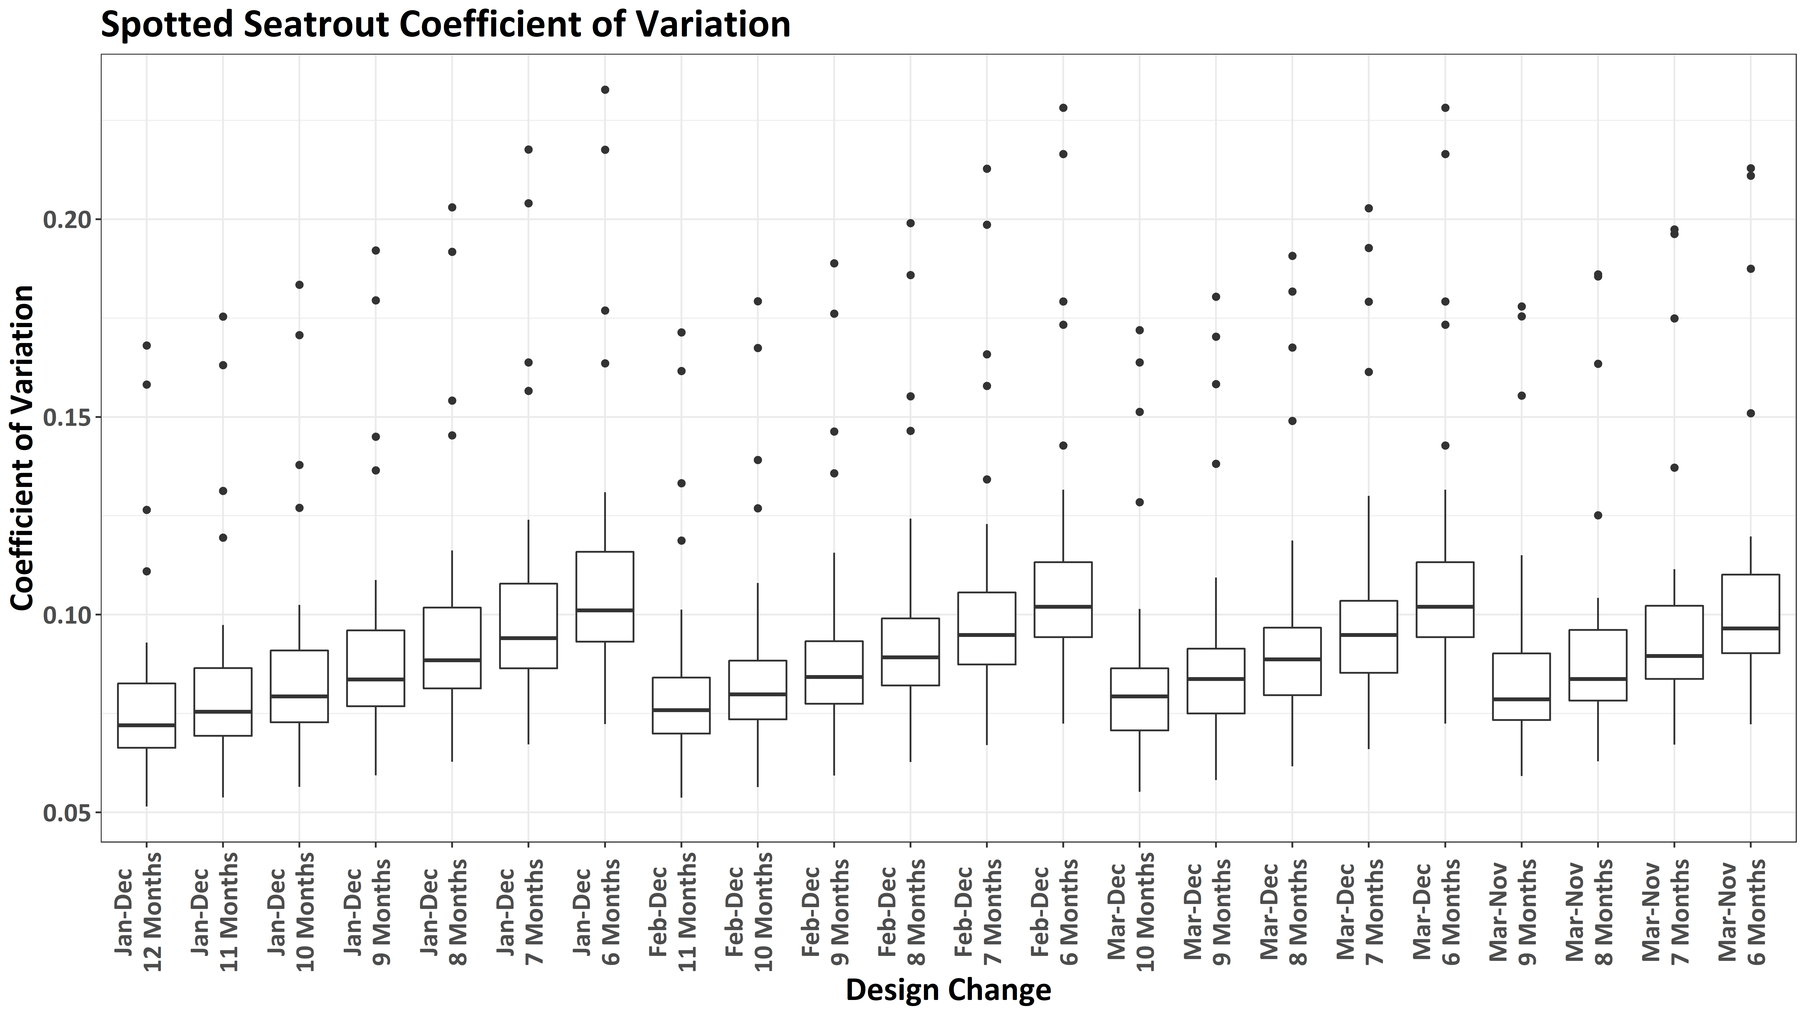
Notes:
This relative insensitivity of the nominal index to survey design changes for Spotted Seatrout is also apparent when we look at how the CV across all years of the survey changes under different scenarios.
For spotted seatrout, this confirms what I said earlier – the nominal index is relatively insensitive to survey design changes, with expected median CVs always <0.2.

Slide 29
How would it have affected our understanding of Southern Flounder relative abundance?

Slide 30
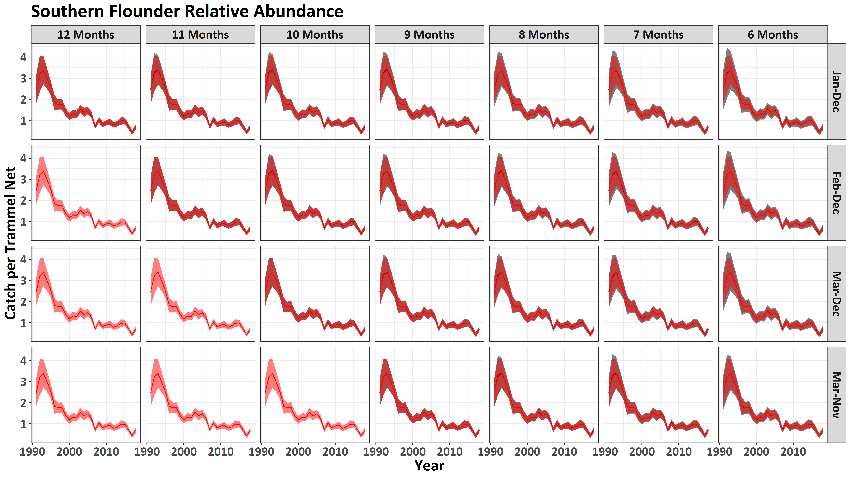
Notes:
As with the previous species, when we calculate the index and confidence interval under various survey design changes, we do not see any degradation relative to the original abundance index. For this species, there seems to be virtually no loss of information content if we reduce survey effort.

Slide 31
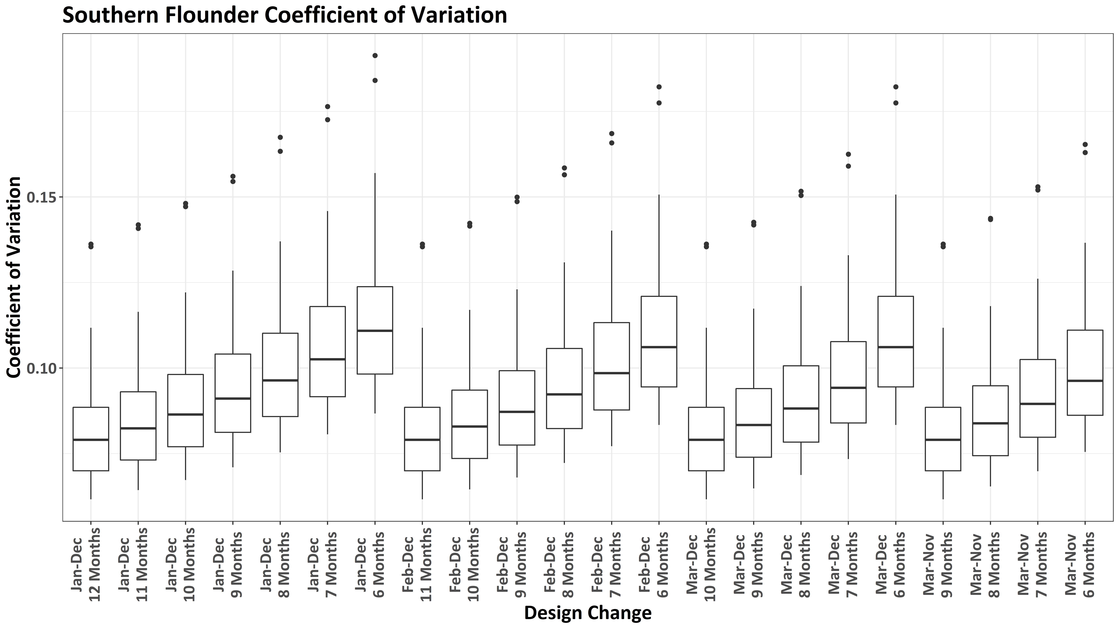
Notes:
This relative insensitivity of the nominal index to survey design changes for Southern Flounder is also apparent when we look at how the CV across all years of the survey changes under different scenarios.
For southern flounder, this confirms what I said earlier – the nominal index is insensitive to survey design changes, with expected median CVs always <0.2. In fact, none of the outliers even exceed 0.2

Slide 32
How would it have affected our understanding of Black Drum relative abundance?

Slide 33
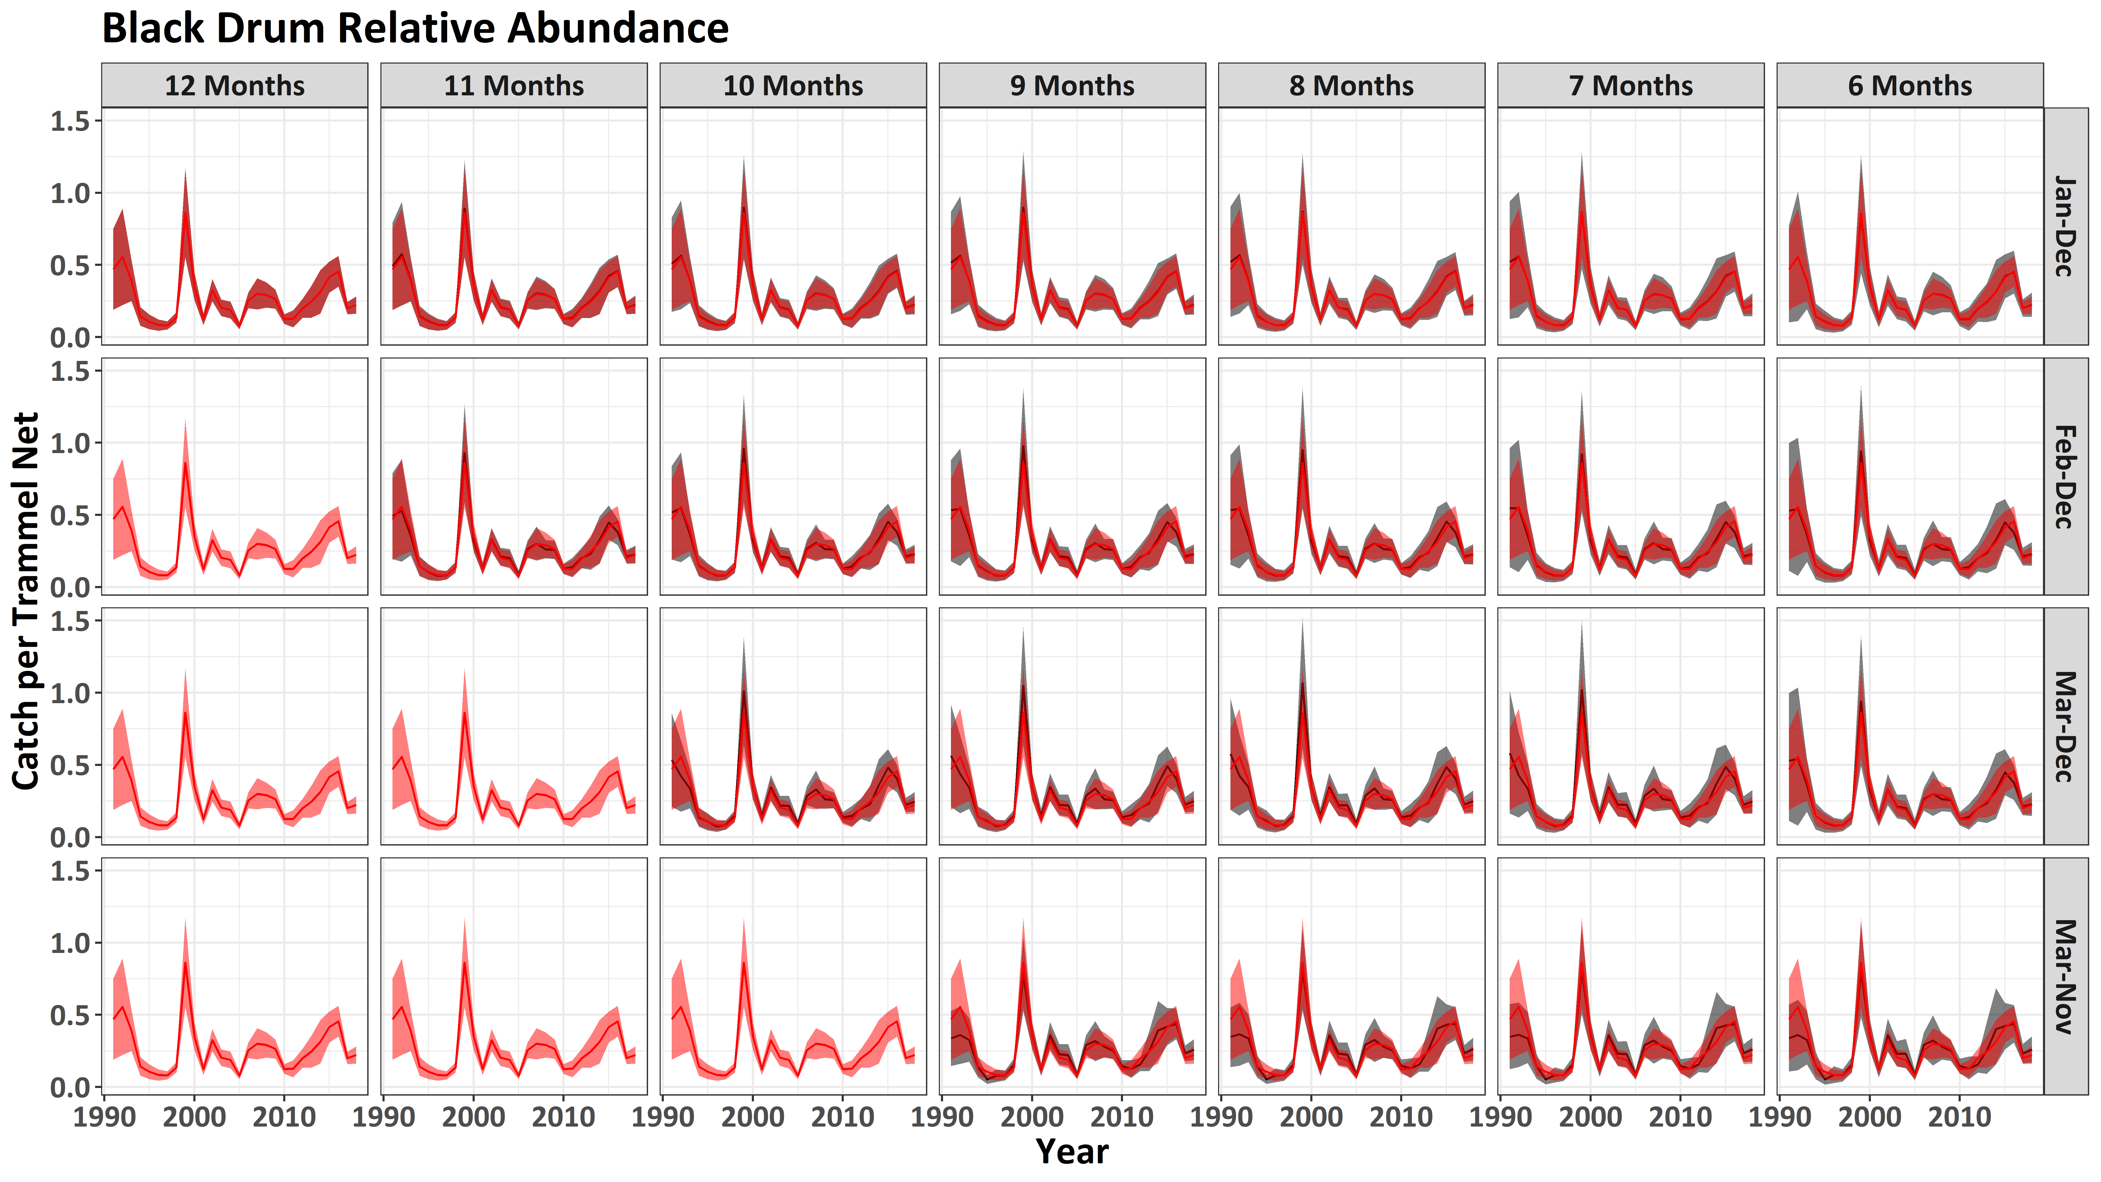
Notes:
As with the other species, when we calculate the index under different survey designs, we do not really see much degradation relative to the original abundance index when we focus on the period since 2003, There is some indication of higher uncertainty in some years, but the overall pattern does not change substantially
The higher uncertainty in individual years, is likely due to relatively low encounter probability of black drum relative to the previous species, as they are only the 15th most common species in the survey, with about 5600 being encountered over the life of the survey.

Slide 34
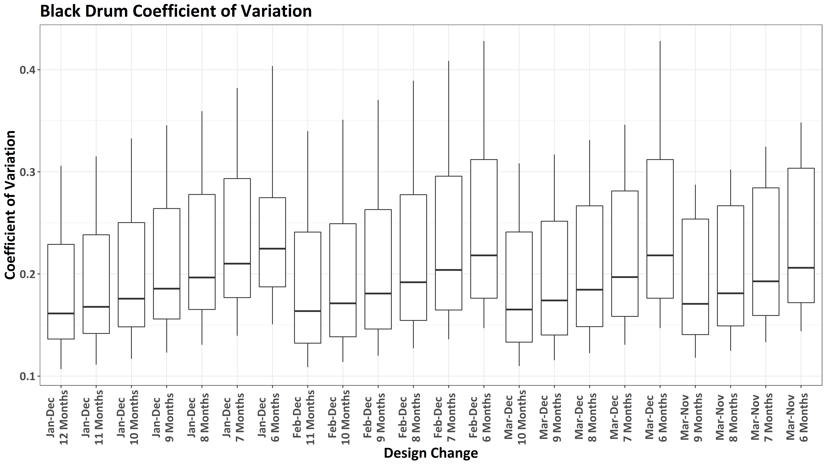
Notes:
However, despite the relative insensitivity of the relative abundance trends to survey design changes, for black drum we are starting to have higher CV estimates in general. This is because of their lower frequency of occurrence in the survey. In fact, there are some combinations where we could expect the median CV estimates for the index to exceed that 0.2 threshold that is generally used for fishery-independent surveys. These would be reductions in sampling effort that would not be attractive for this species.
Note though that for a given sampling frequency, you get lower uncertainty if you restrict the sampling season to a shorter time frame. This is likely because of the relative in-frequent occurrence of black drum during the winter months and the “boom” or “bust” pattern.

Slide 35
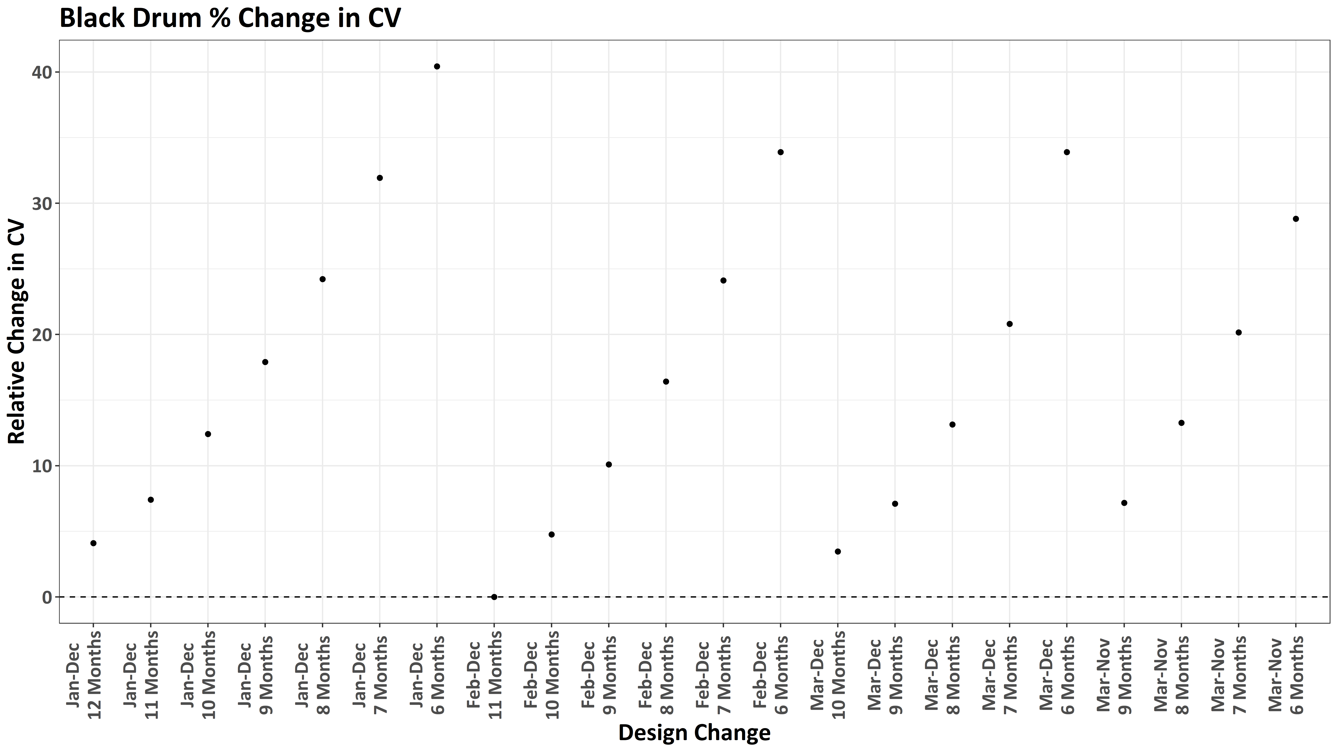
Notes:
This is most apparent when we look at the % change in relative CV across all survey design changes. In the case of Black Drum, we would actually expect higher precision if we restrict our sampling to only the months of February-December.

Slide 36
How would it have affected our understanding of Sheepshead relative abundance?

Slide 37
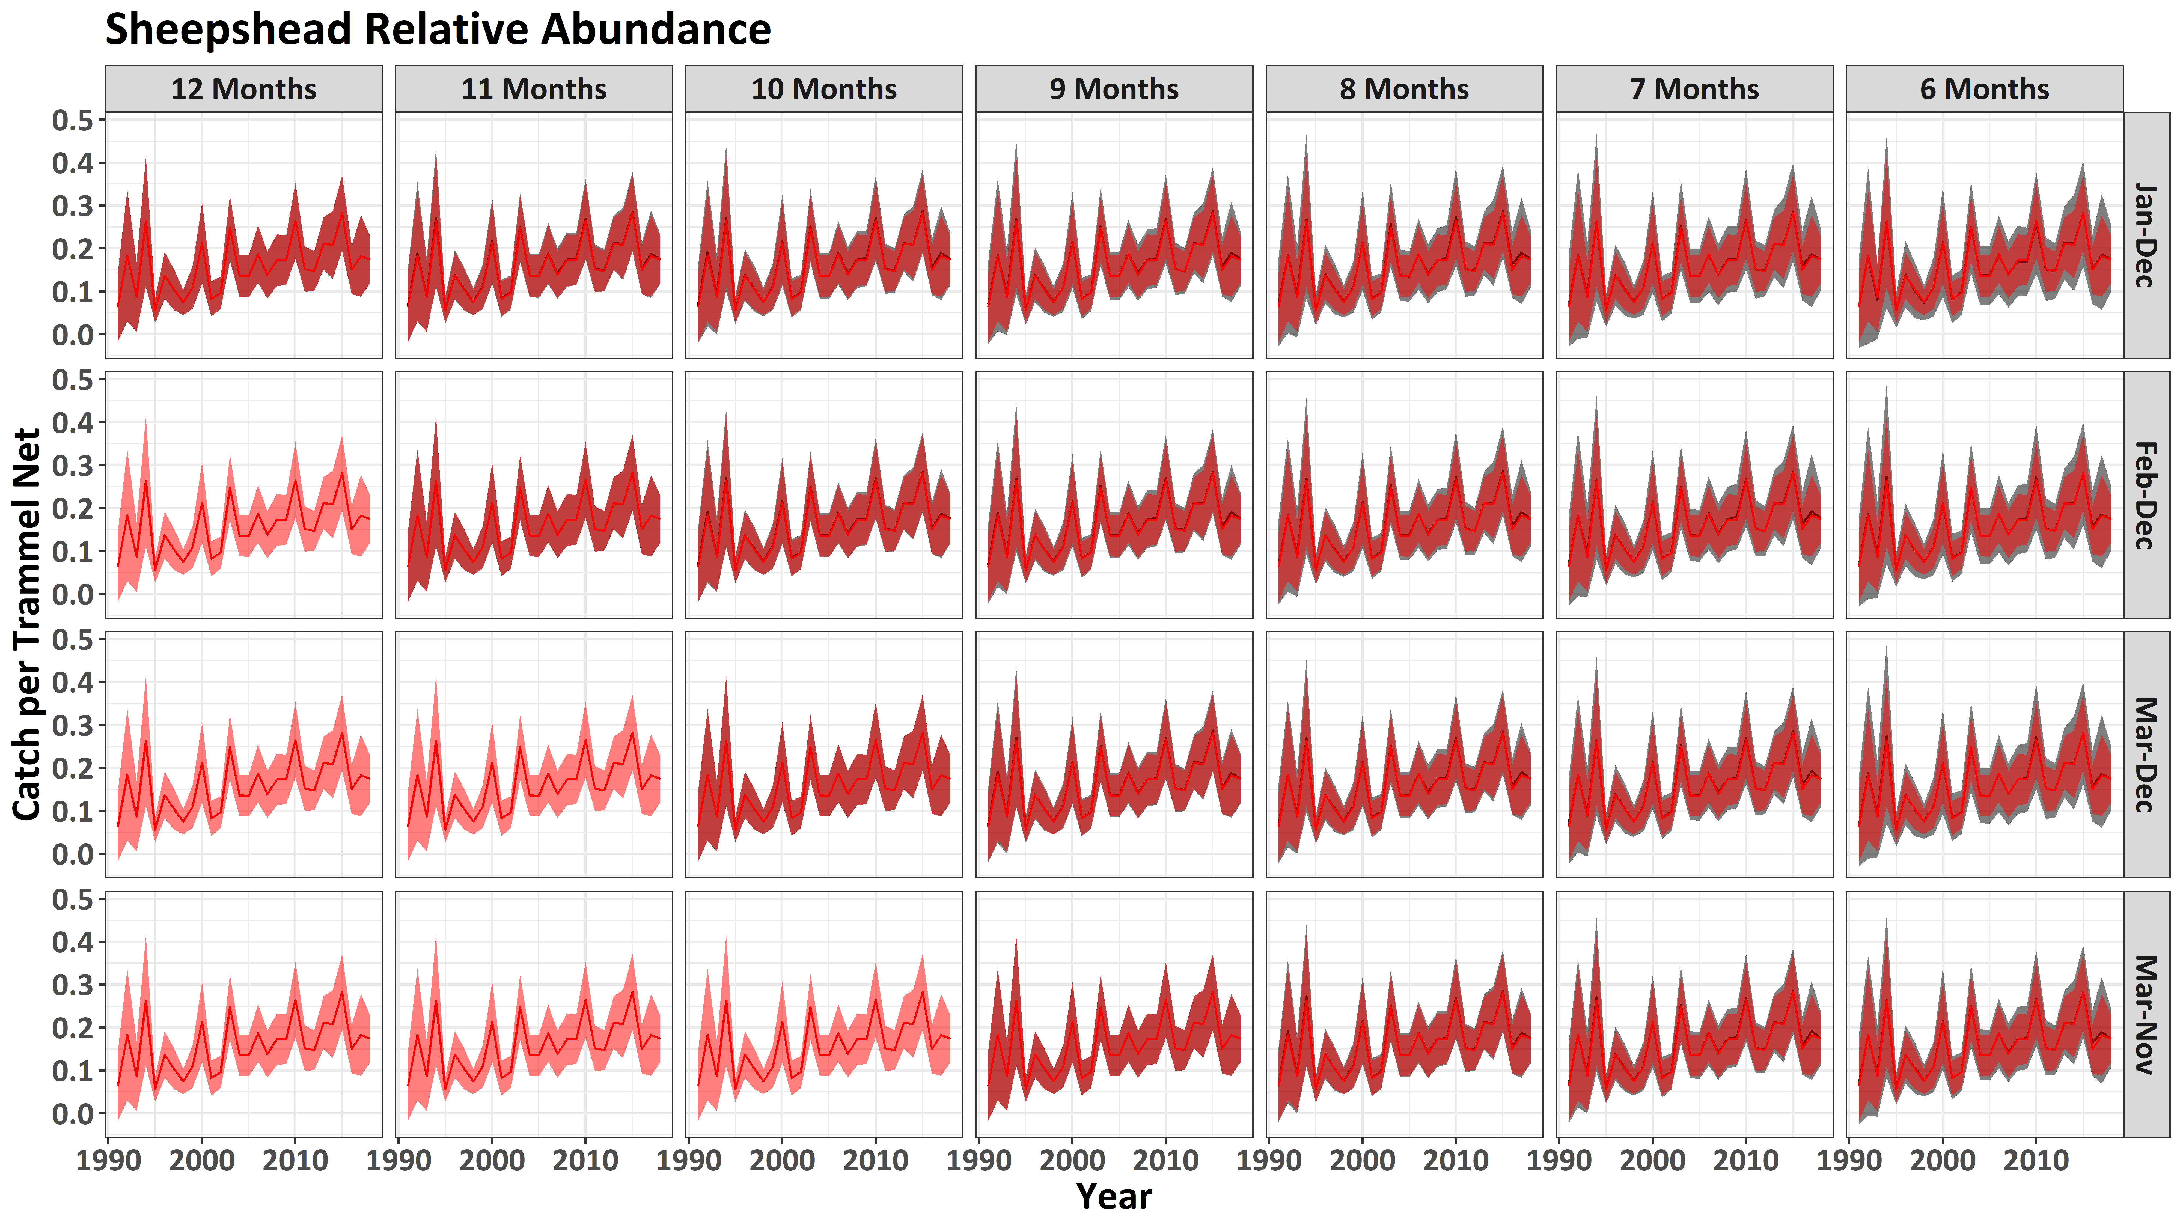
Notes:
As with the other species, when we calculate the median nominal index (black line) and median 95% ci (gray shaded region), we do not see much degradation relative to the original abundance index.

Slide 38

Notes:
However, despite the relative insensitivity of the relative abundance trends to survey design changes, for sheepshead there are many combinations where we are starting to have higher CV estimates in general – in fact, even with status quo we are only barely below the 0.2 cutoff with regards to median CV. This is because of their lower frequency of occurrence in the survey. There are many combinations where we could expect the median CV estimates for the index to exceed that 0.2 threshold that is generally used for fishery-independent surveys. These would be reductions in sampling effort that would not be attractive for this species.
Note though that for a given sampling frequency, you get lower uncertainty if you restrict the sampling season to a shorter time frame. This is because we rarely encounter sheepshead during “winter” months. For this reason, we could restrict our sampling season to Mar-Nov and sample every month and still maintain our current uncertainty relative to sheepshead relative abundance. This is depicted here

Slide 39

Notes:
where we see the relative change in median CV estimates. And though CV does degrade, many other combinations allow for less than a 10% increase in CV relative to current levels.

Slide 40
How would it have affected our understanding of Bluefish relative abundance?

Slide 41
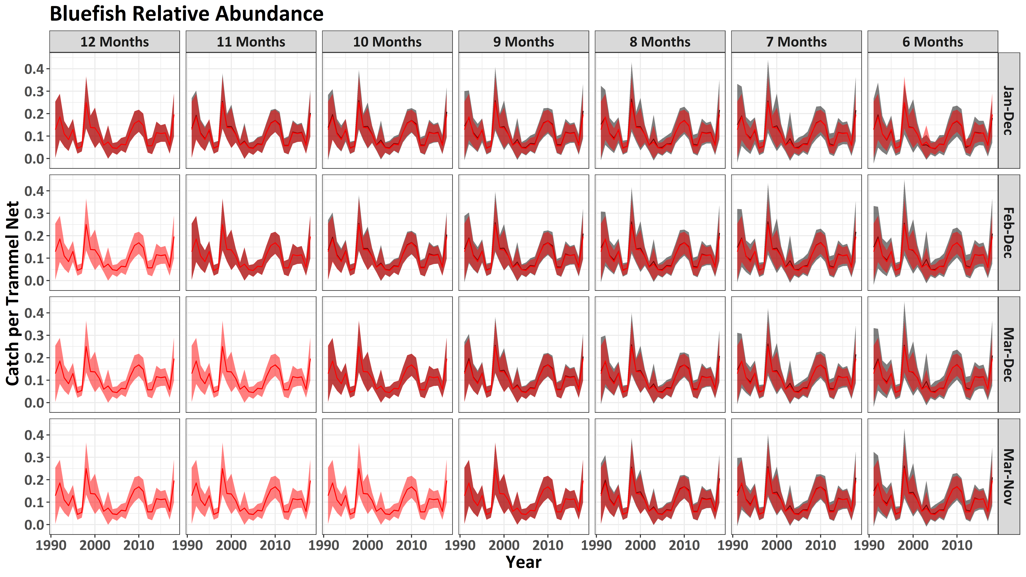
Notes:
Finally, even when we get all the way down to bluefish, the last species for which we have averaged catching >50 individuals annually, we still do not see a significant degradation in our ability to track relative abundance.

Slide 42
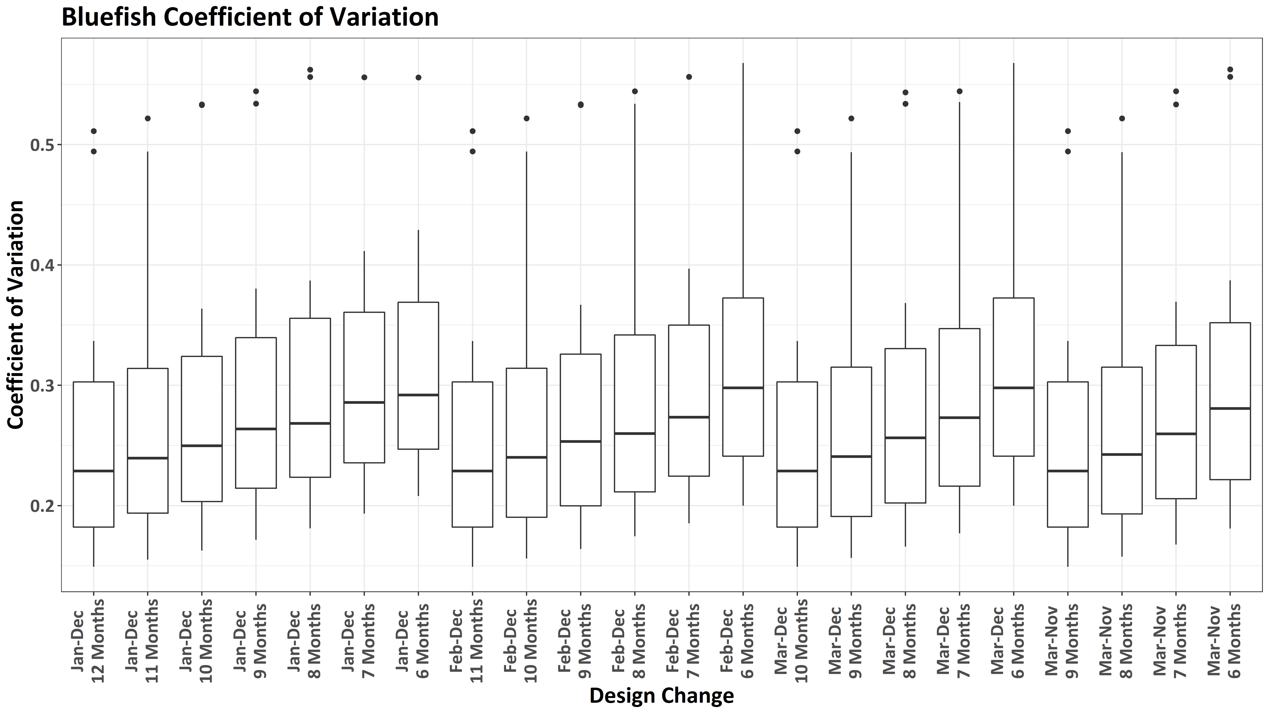
Notes:
Unfortunately though, even current survey efforts do not allow us to achieve the magic 0.2 for CV, at least for the median. This is to be expected given bluefish are actually pretty rare occurrences in the trammel net survey, having only encountered approximately 1600 over the life of the survey.
Further, because this species is already seasonal in in nature,

Slide 43
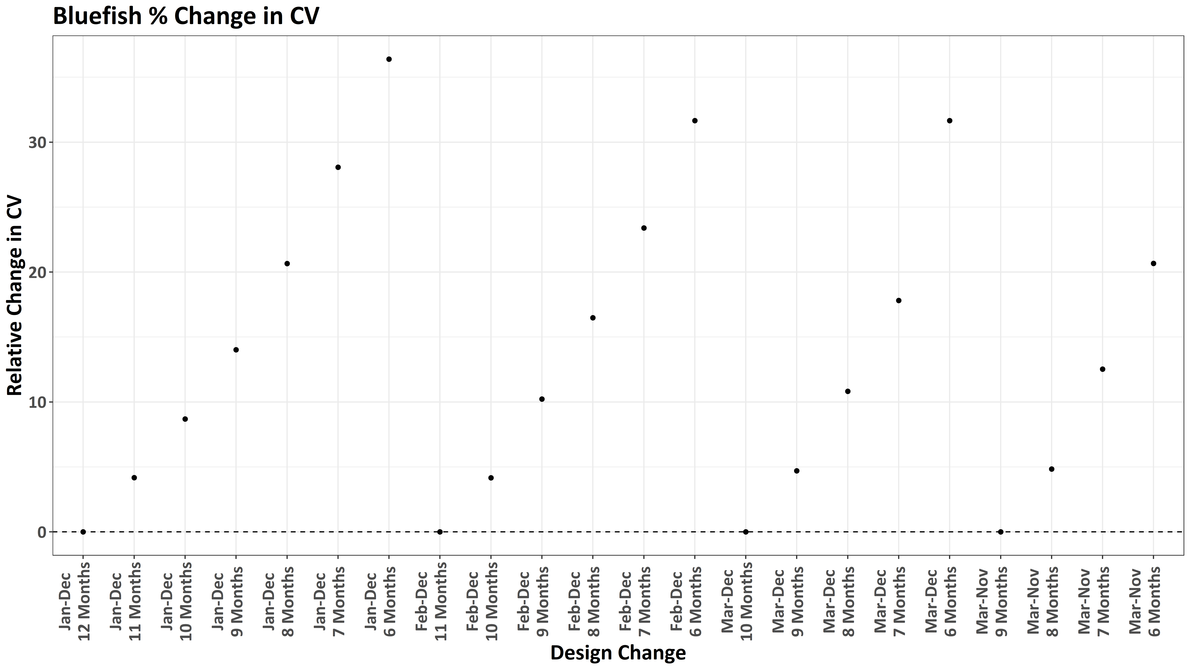
Notes:
we can reduce the sampling season to March – November and obtain the same CV estimates, with other combinations providing <10% increase in relative CV.

Slide 44
All median CV estimates <0.2
Transitional (some median CVs <0.2; some median CVs >0.2); Suggest March – November season adequate
All median CV estimates >0.2; March-November season adequate
Notes:
In fact, if I try to summarize the effects of survey design changes across all 24 species for which we encounter >50 annually on average, we get three different groupings.
First, for our most abundant species, we get median annual CV estimates <0.2 regardless of our survey design.
Then we have a transitional list of species, where for some species we never can obtain our median annual CV estimate of >0.2, for others most or all median annual CV estimates are <0.2. With that said, for all it appears in general a March-November sampling season would be adequate as there isn’t much if anything to be gained by sampling during the months of November, December and January.
Finally, for our rarer species we can never achieve a median CV <0.2; that said, a March-November season seems adequate as nothing is gained by sampling in the months of November, December, and January

Slide 45
How do survey design changes affect overall uncertainty across species?

Slide 46
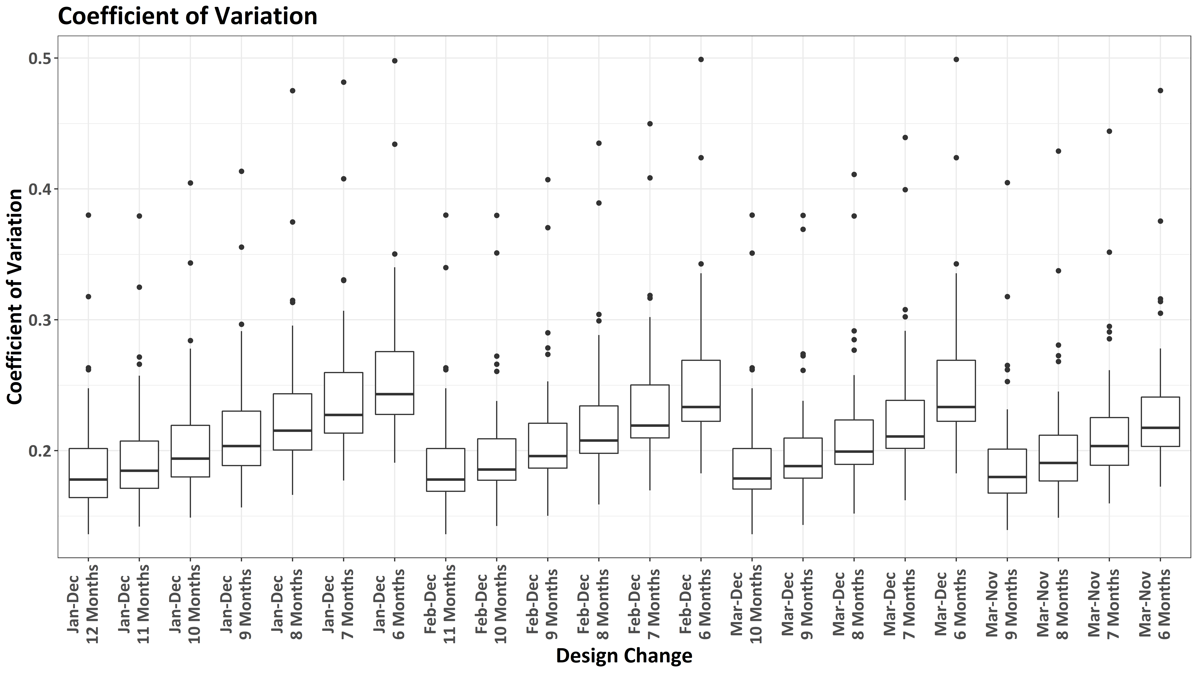
Notes:
When we look at how the median CV changes across all 24 species for which we have averaged catching >50 individuals annually, several survey design changes allow us to maintain a median CV less than 0.2. In fact, for a given number of sampling days, we can achieve more bang for the buck by shortening the sampling season, with the most extreme of which would be to reduce the sampling season to March-November, with only 8 of the 9 months being sampled for each strata during each year. This represents a 39% reduction in sampling effort with only a marginal increase in median CV across all species.

Slide 47
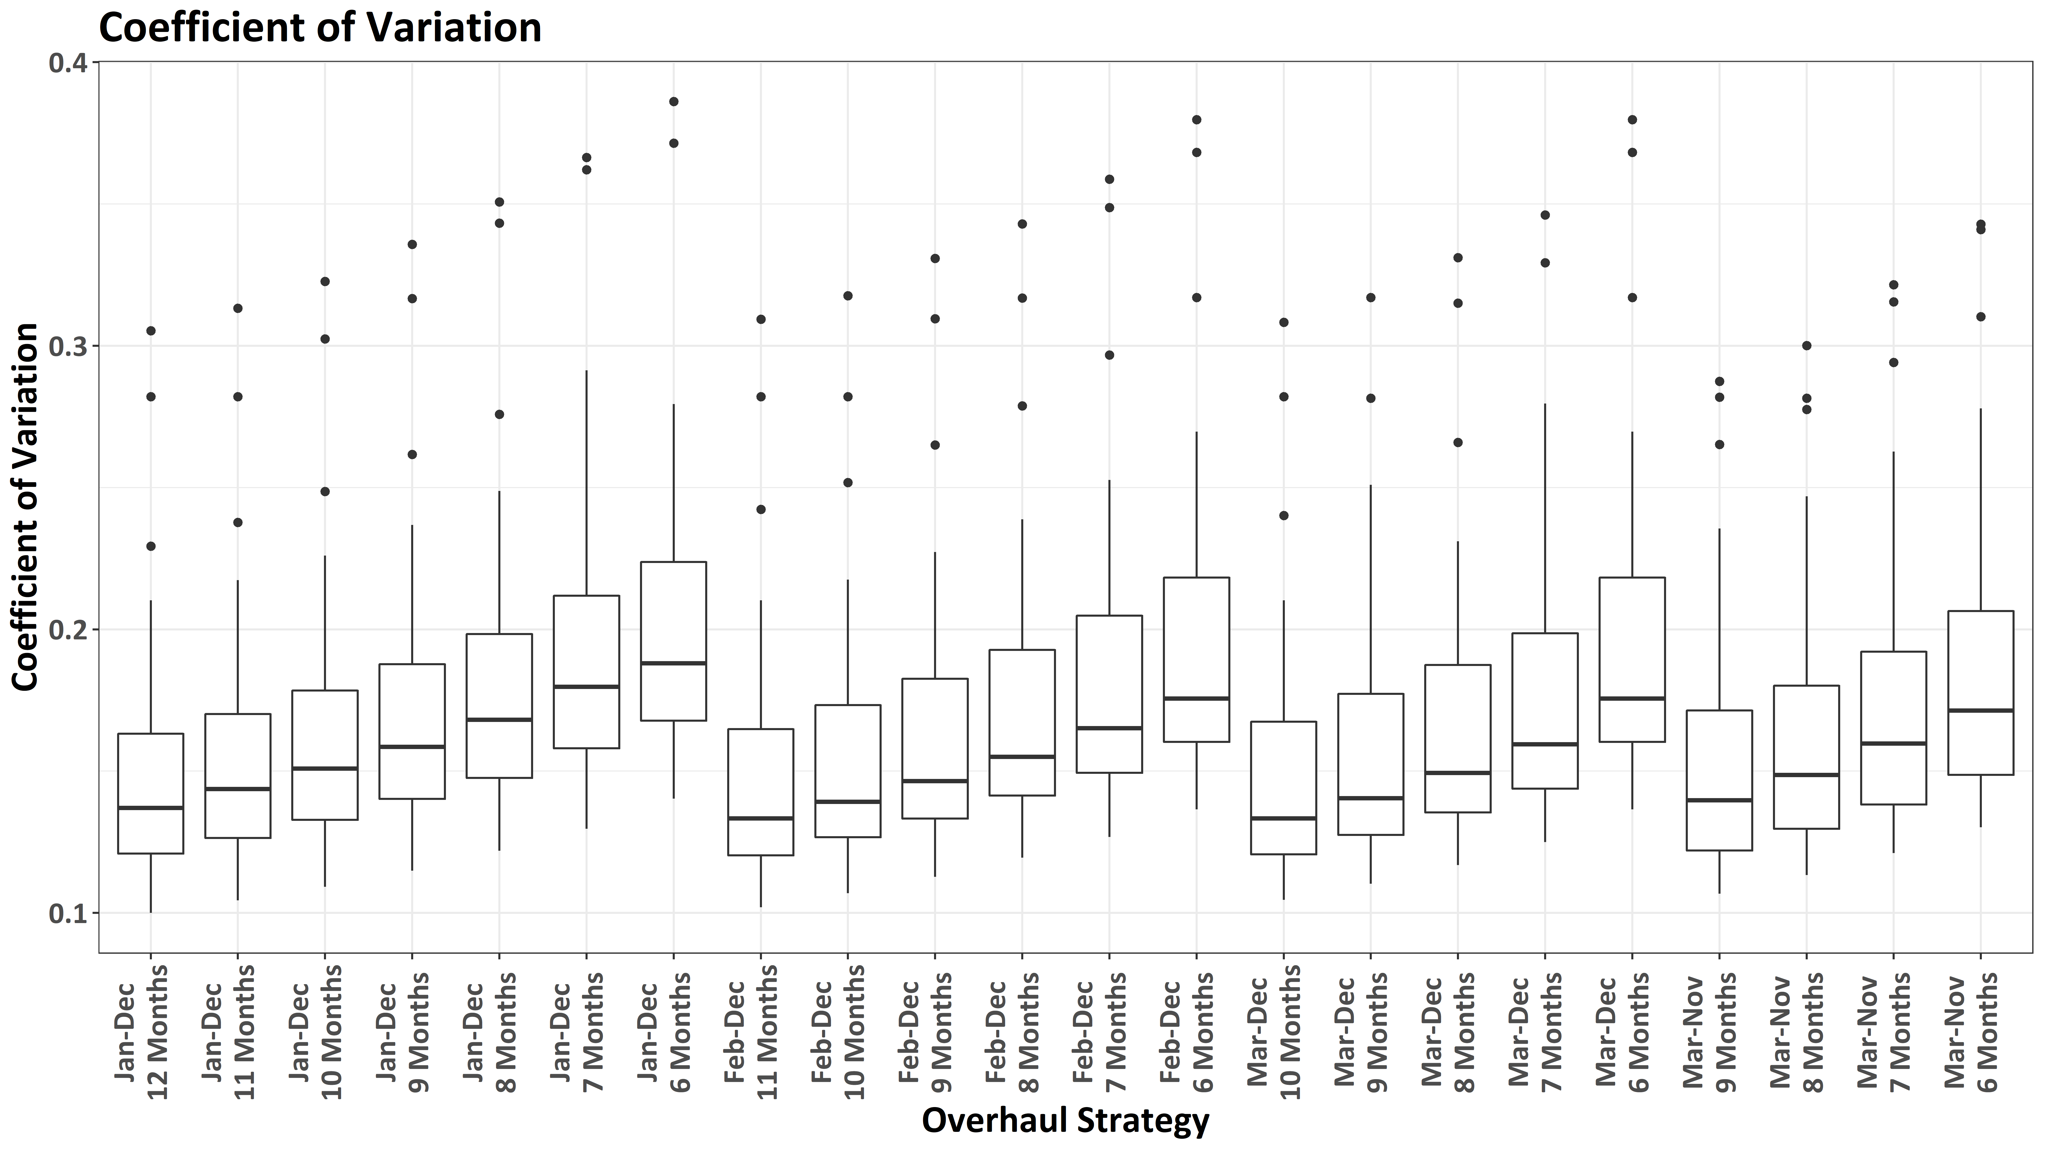
Notes:
Further, we can maintain our median CV across select species below the magic 0.2 level under all survey design change scenarios.

Slide 48
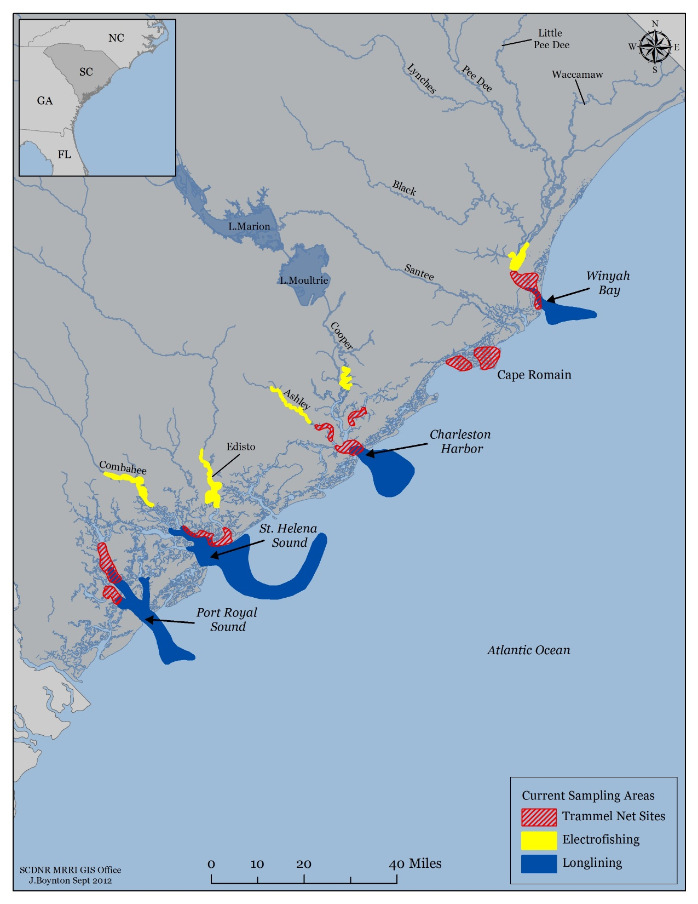
Electrofishing Survey – Current Effort
Strata
Monthly = 5 (CM, LE, UA, UC, EW)
Field Days = 60
3 staff/field day
Staff Man Years
0.88 years – field only (40% of time)
1.32 years – lab/office only (60% of time)
Total Staff Time: 2.20 years
Notes:
Currently, inshore fisheries is sampling 5 different estuarine strata monthly
This equates to 60 field days, with each field day requiring 3 field staff.
If we convert these field days to staff work years required to run this survey, using average times it takes to complete a sampling day in each strata, this equates to 0.88 man years of field time. If we further assume that field time only represents 40% of the total time needed annually for survey related activities, we need an additional 1.32 man years of lab/office time.
Thus, in total, it takes almost 7 full time staff to only operate our trammel net survey.

Slide 49
Number: frequency “monthly” strata sampled per year
Status quo: PRS sampled quarterly, as current
Merge strata: merge Cape Romain & PRS strata
Notes:
When considering the frequency of sampling, an important consideration is how much of a reduction in field time one can expect under the different scenarios, which is what I’m showing here.
If we target a similar reduction in the electrofishing survey as we targeted for the trammel net survey, we would want to consider targeting a 20-40% reduction in field time annually.

Slide 50
Number: frequency “monthly” strata sampled per year
Status quo: PRS sampled quarterly, as current
Merge strata: merge Cape Romain & PRS strata
Notes:
Under this assumption, we would target sampling each electrofishing strata 8-9 times annually.

Slide 51
All Months of the Year
January – December
What months should we conduct sampling?
February – December
(11 Months of the Year)
Certain Months of the Year?
March – December
(10 Months of the Year)
March – November
(9 Months of the Year
Notes:
As we did with the trammel net survey, we can also ask the question wat months should we conduct sampling?
Should we continue to operate the electrofishing survey during all months of the year?
Or should we only operate the electrofishing survey during certain months of the year? If only certain months, what months? With the most likely months that could be dropped without significantly affecting our ability to detect trends in our most commonly encountered species being the winter months of December, January, and February. This is because these are the months when catches are generally the lightest, and…

Slide 52
Notes:
When we look at the 29 species encountered by the electrofishing survey, for which we have averaged encountering greater than >50 annually since the start of the survey, we see that none are encountered exclusively during the months of December, January, and February. The closest of these is white mullet, which is encountered predominately from October to December

Slide 53
What would the impact of survey design changes to the electrofishing survey have on our ability to track changes in species relative abundance?
Key factors to consider: 1) How does it affect our uncertainty and 2) Does the trend in abundance change?
Notes:
Now that I’ve laid out the questions, and some potential options, the question becomes how could we try and anticipate how survey design changes will affect our ability to track changes in individual and ecosystem level relative abundances? Key factors to consider in this discussion is how would it affect our measures of uncertainty relative to annual abundance estimates and how would we expect the trend in abundance to change?

Slide 54
How investigated?
Inshore has been sampling 5 strata monthly
Earliest years, only a few of the strata existed
All strata existed since 2004 – added Winyah Bay / Waccamaw River
Used same techniques as used for the electrofishing survey to investigate how sampling design changes would have affected relative abundance and uncertainty measures
Notes:
To answer these questions, I made use of historical data we have available form 5 strata that we have been sampling 12 times a year. That said, in the earliest years, only a few of the strata existed, but all strata have existed since 2004, when we added Winyah Bay / Waccamaw River

Slide 55
How would it have affected our understanding of Red Drum relative abundance?

Slide 56
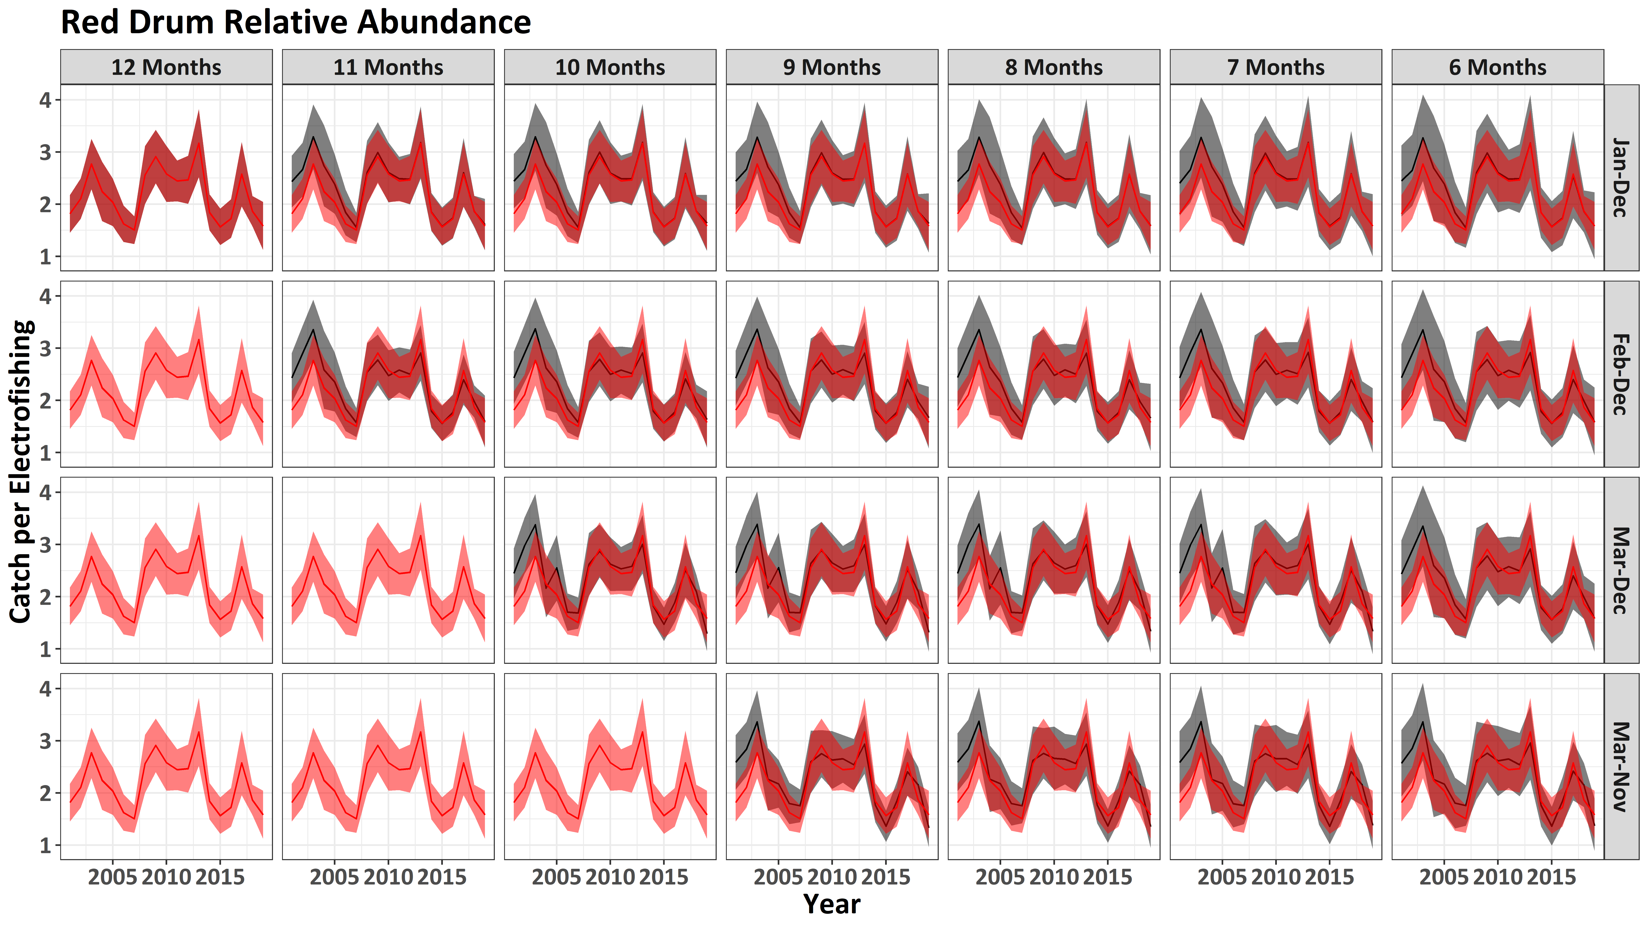
Notes:
The red box once again identifies the combinations that would allow for a 20-40% reduction in sampling effort for the electrofishing survey.
When we calculate the median nominal index (black line) and median 95% ci (gray shaded region), we do not really see much degradation relative to the original abundance index when we focus, except for during the earliest years of the survey. This could be the results of Winyah Bay not coming fully online until a couple of years into the electrofishing survey.
This relative insensitivity to survey design changes for Red Drum is likely the result of their abundance in the survey.

Slide 57
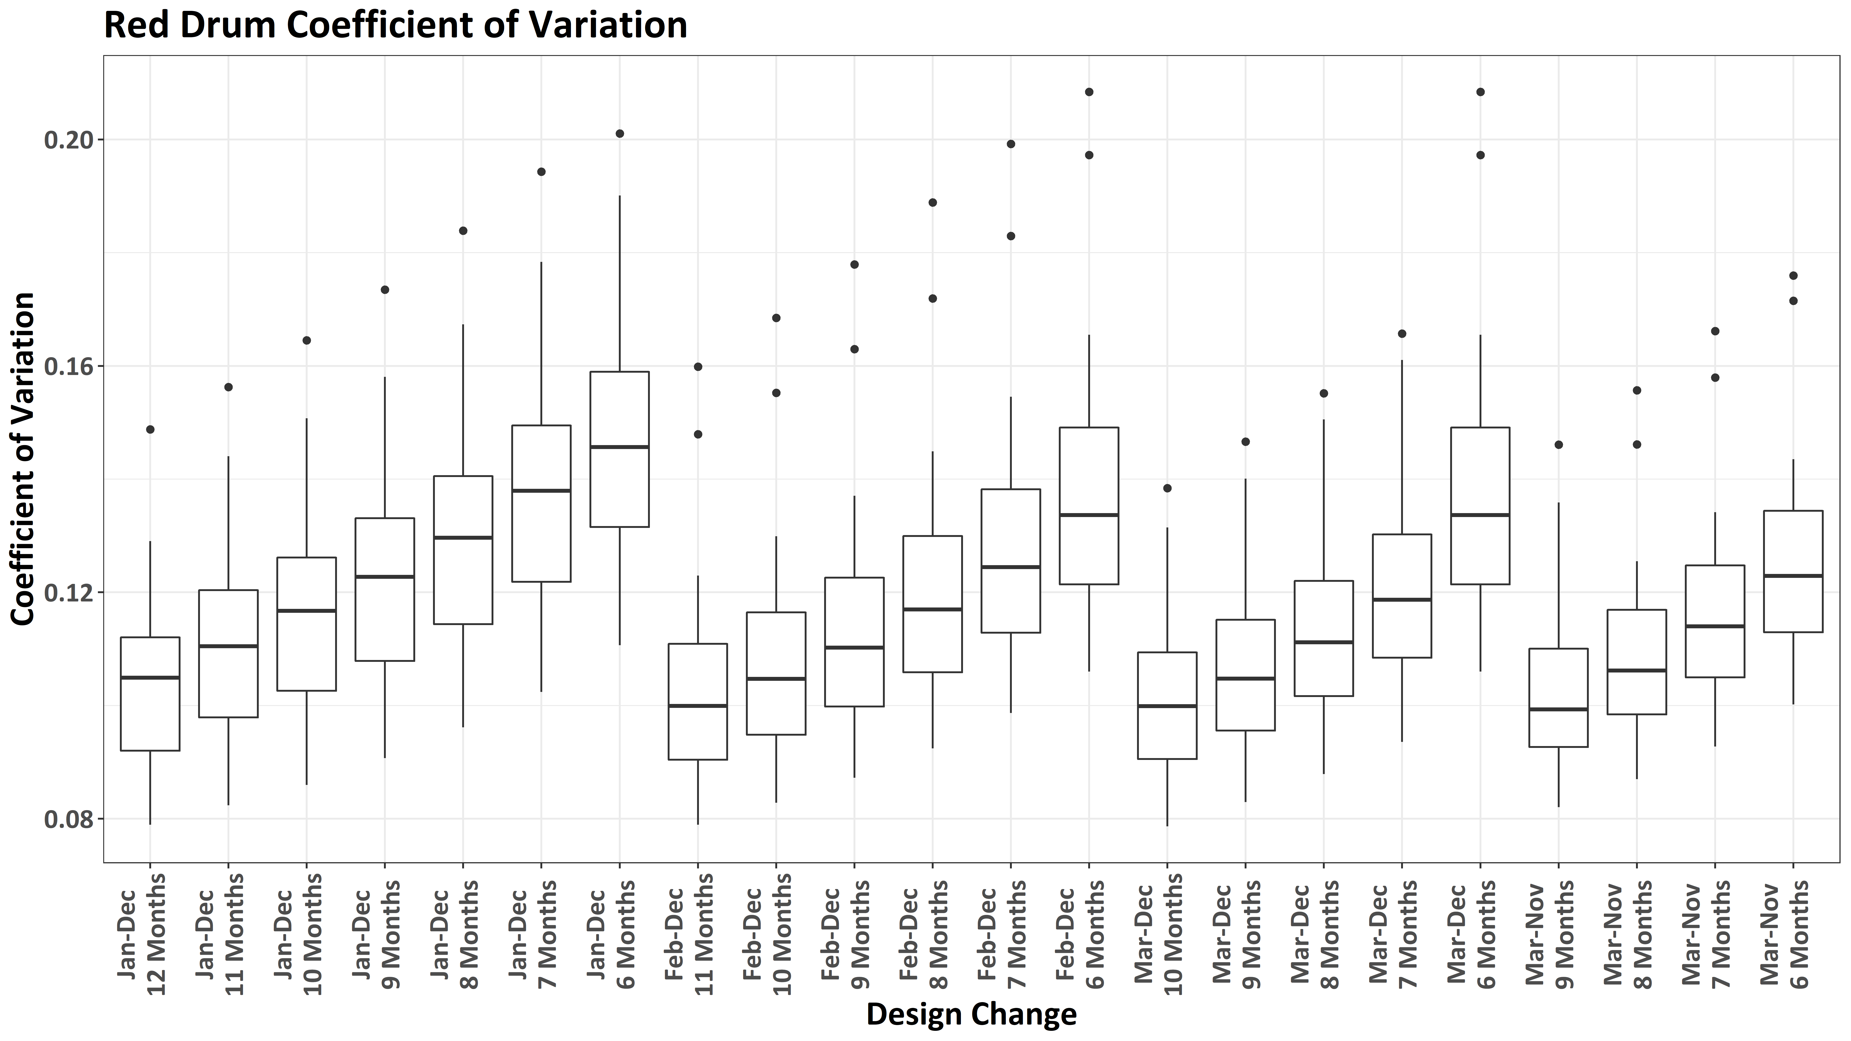
Notes:
This relative insensitivity of the nominal index to survey design changes for Red Drum is also apparent when we look at how the CV across all years of the survey changes under different scenarios. No scenarios produces median CV estimates in excess of 0.2

Slide 58

Notes:
And in fact we can actually get slightly improved CV estimates by reducing the sampling year relative to the current median estimates, particularly if we restrict sampling to March-December or March to NOvember

Slide 59
How would it have affected our understanding of American Eel relative abundance?

Slide 60
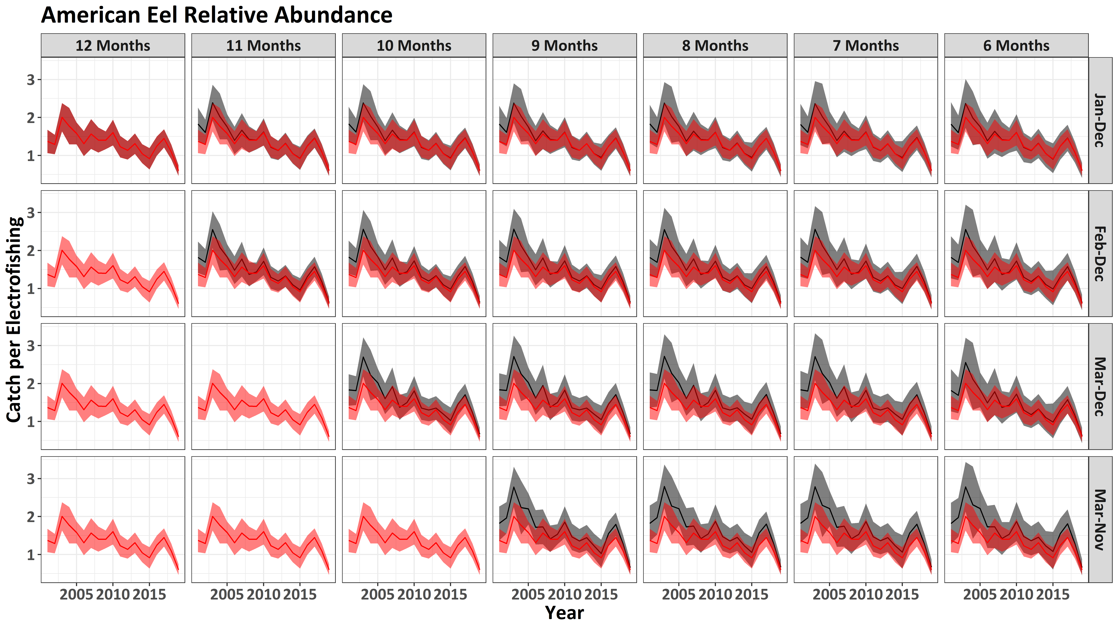
Notes:
For American eel, we also see that the trend in relative abundance is relatively insensitive to survey design changes, though for some scenarios the overall relative abundance is predicted to be somewhat higher for shorter sampling seasons. This is likely because though we catch American eel year round, we catch relatively more of them outside the winter months.

Slide 61
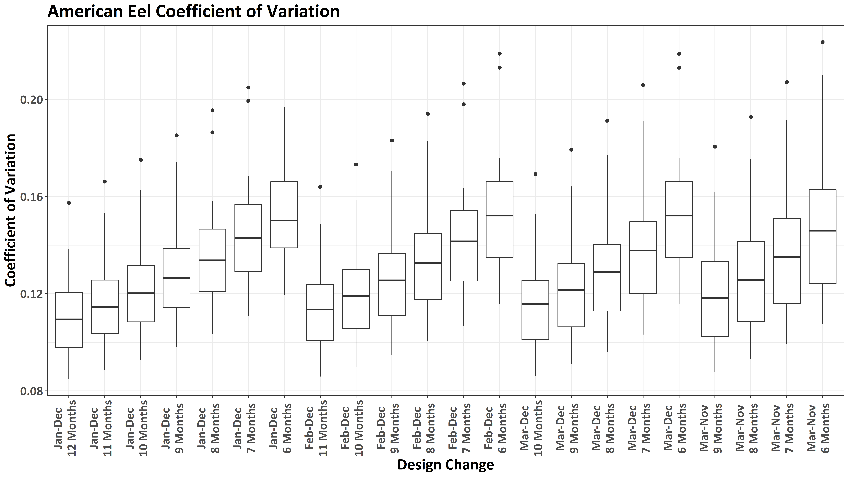
Notes:
This relative insensitivity of the nominal index to survey design changes for American Eel is also apparent when we look at how the CV across all years of the survey changes under different scenarios. No scenarios produces median CV estimates in excess of 0.2

Slide 62
How would it have affected our understanding of Southern Flounder relative abundance?

Slide 63
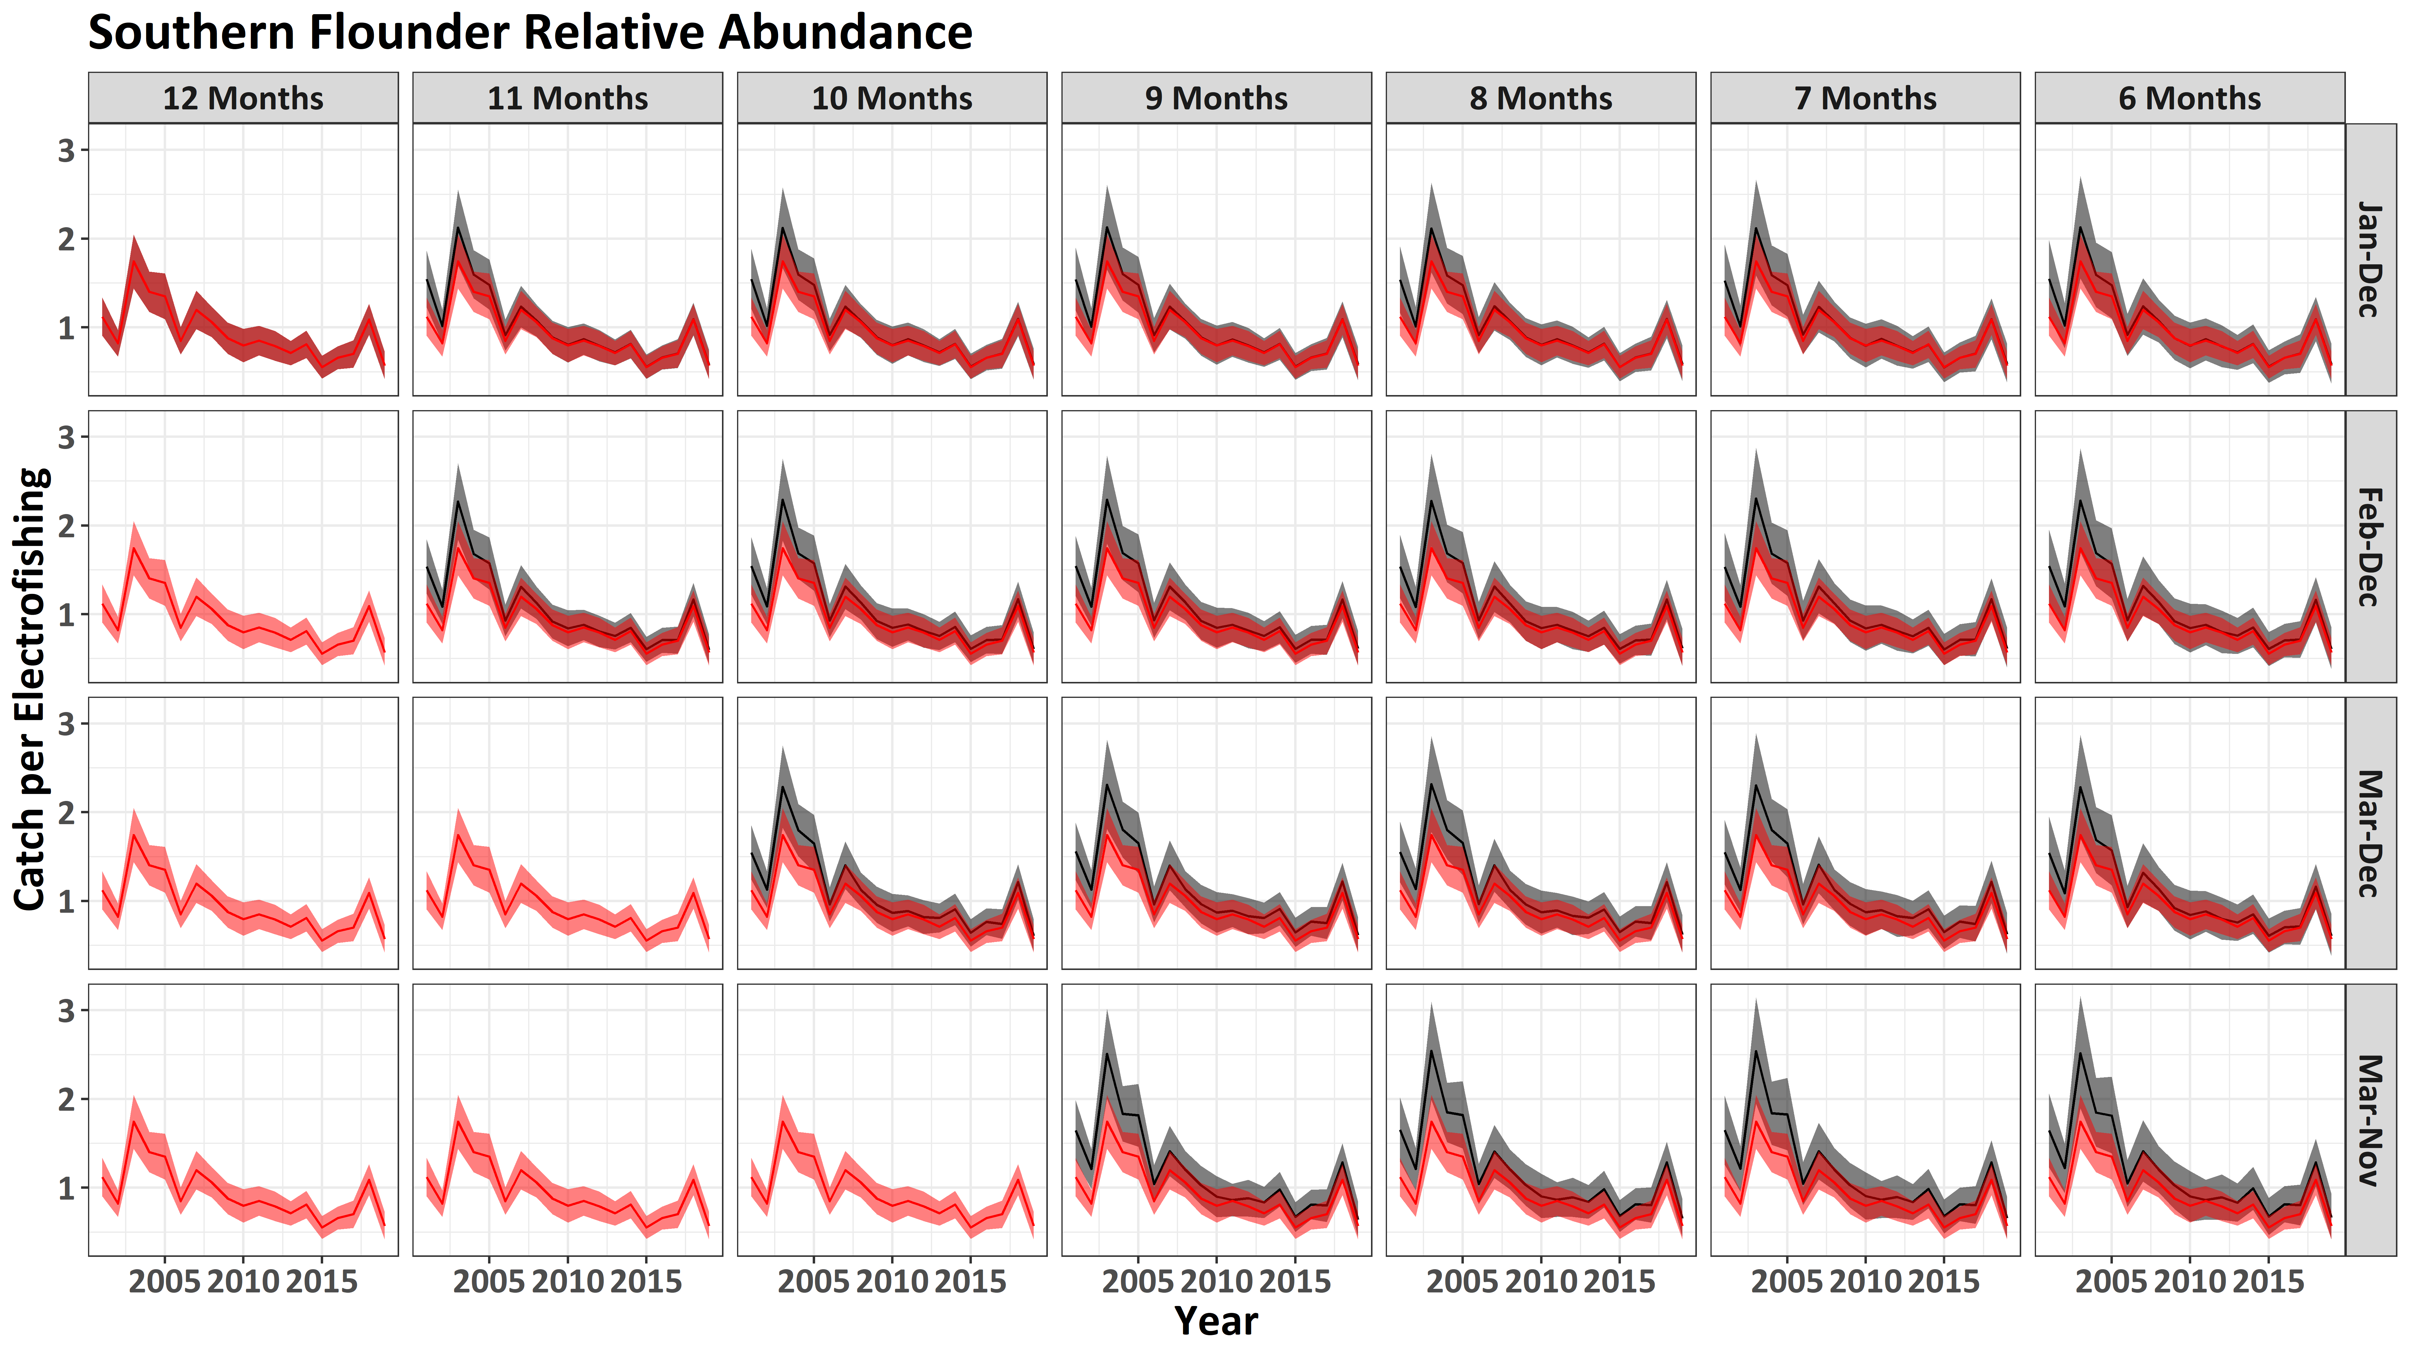
Notes:
Similar to red drum, survey design changes seem to affect the earliest portion of the relative abundance trend the most for Southern Flounder, making it appear there was a slightly steeper decline in general. That said, the trend is relatively consistent and it is unclear how much these early differences are the result of having one less strata sampled.

Slide 64
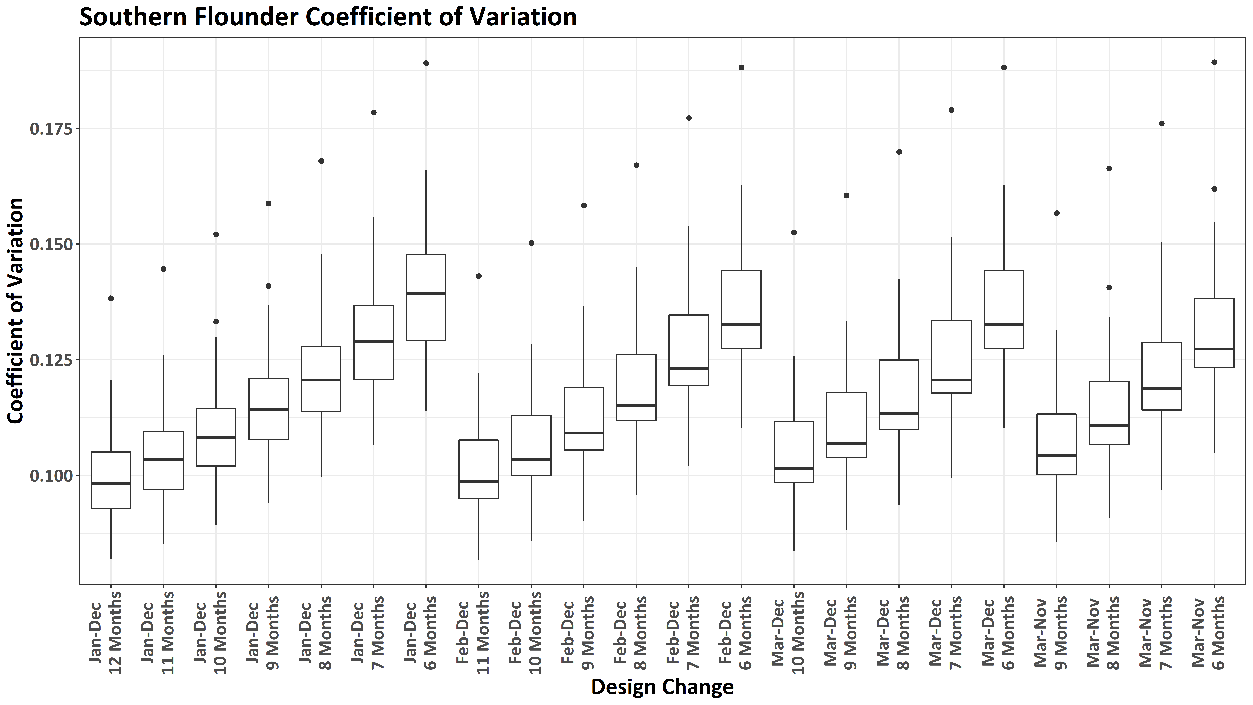
Notes:
Also as was the case for the two previous species, and for Southern Flounder in the trammel net survey, no sampling design change is likely to result in median CV estimates in excess of 0.2

Slide 65
How would it have affected our understanding of Spotted Seatrout relative abundance?

Slide 66
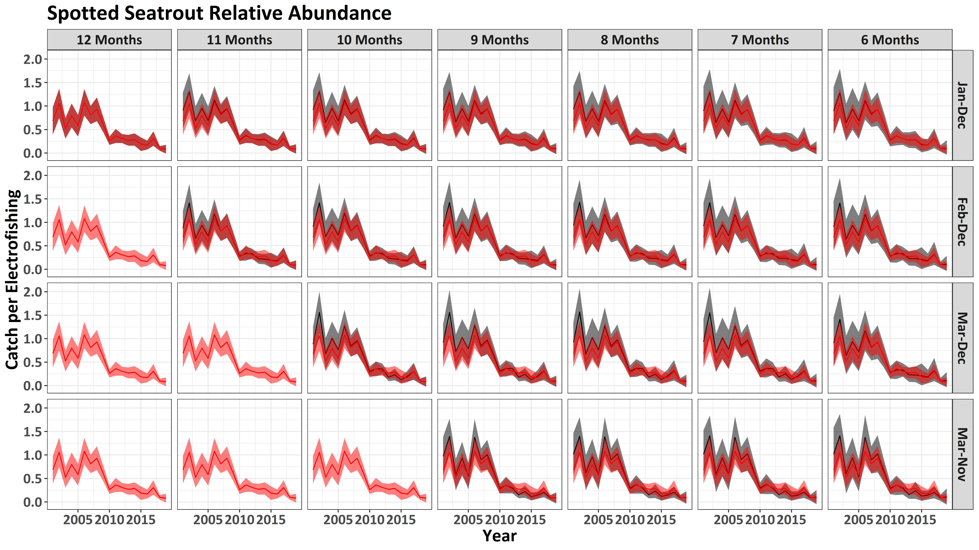
Notes:
A similar story as we have had for all other species investigated for the electrofishing survey emerges for spotted seatrout. Not much effect, and what change does occur tends to occur earlier in the time series.

Slide 67
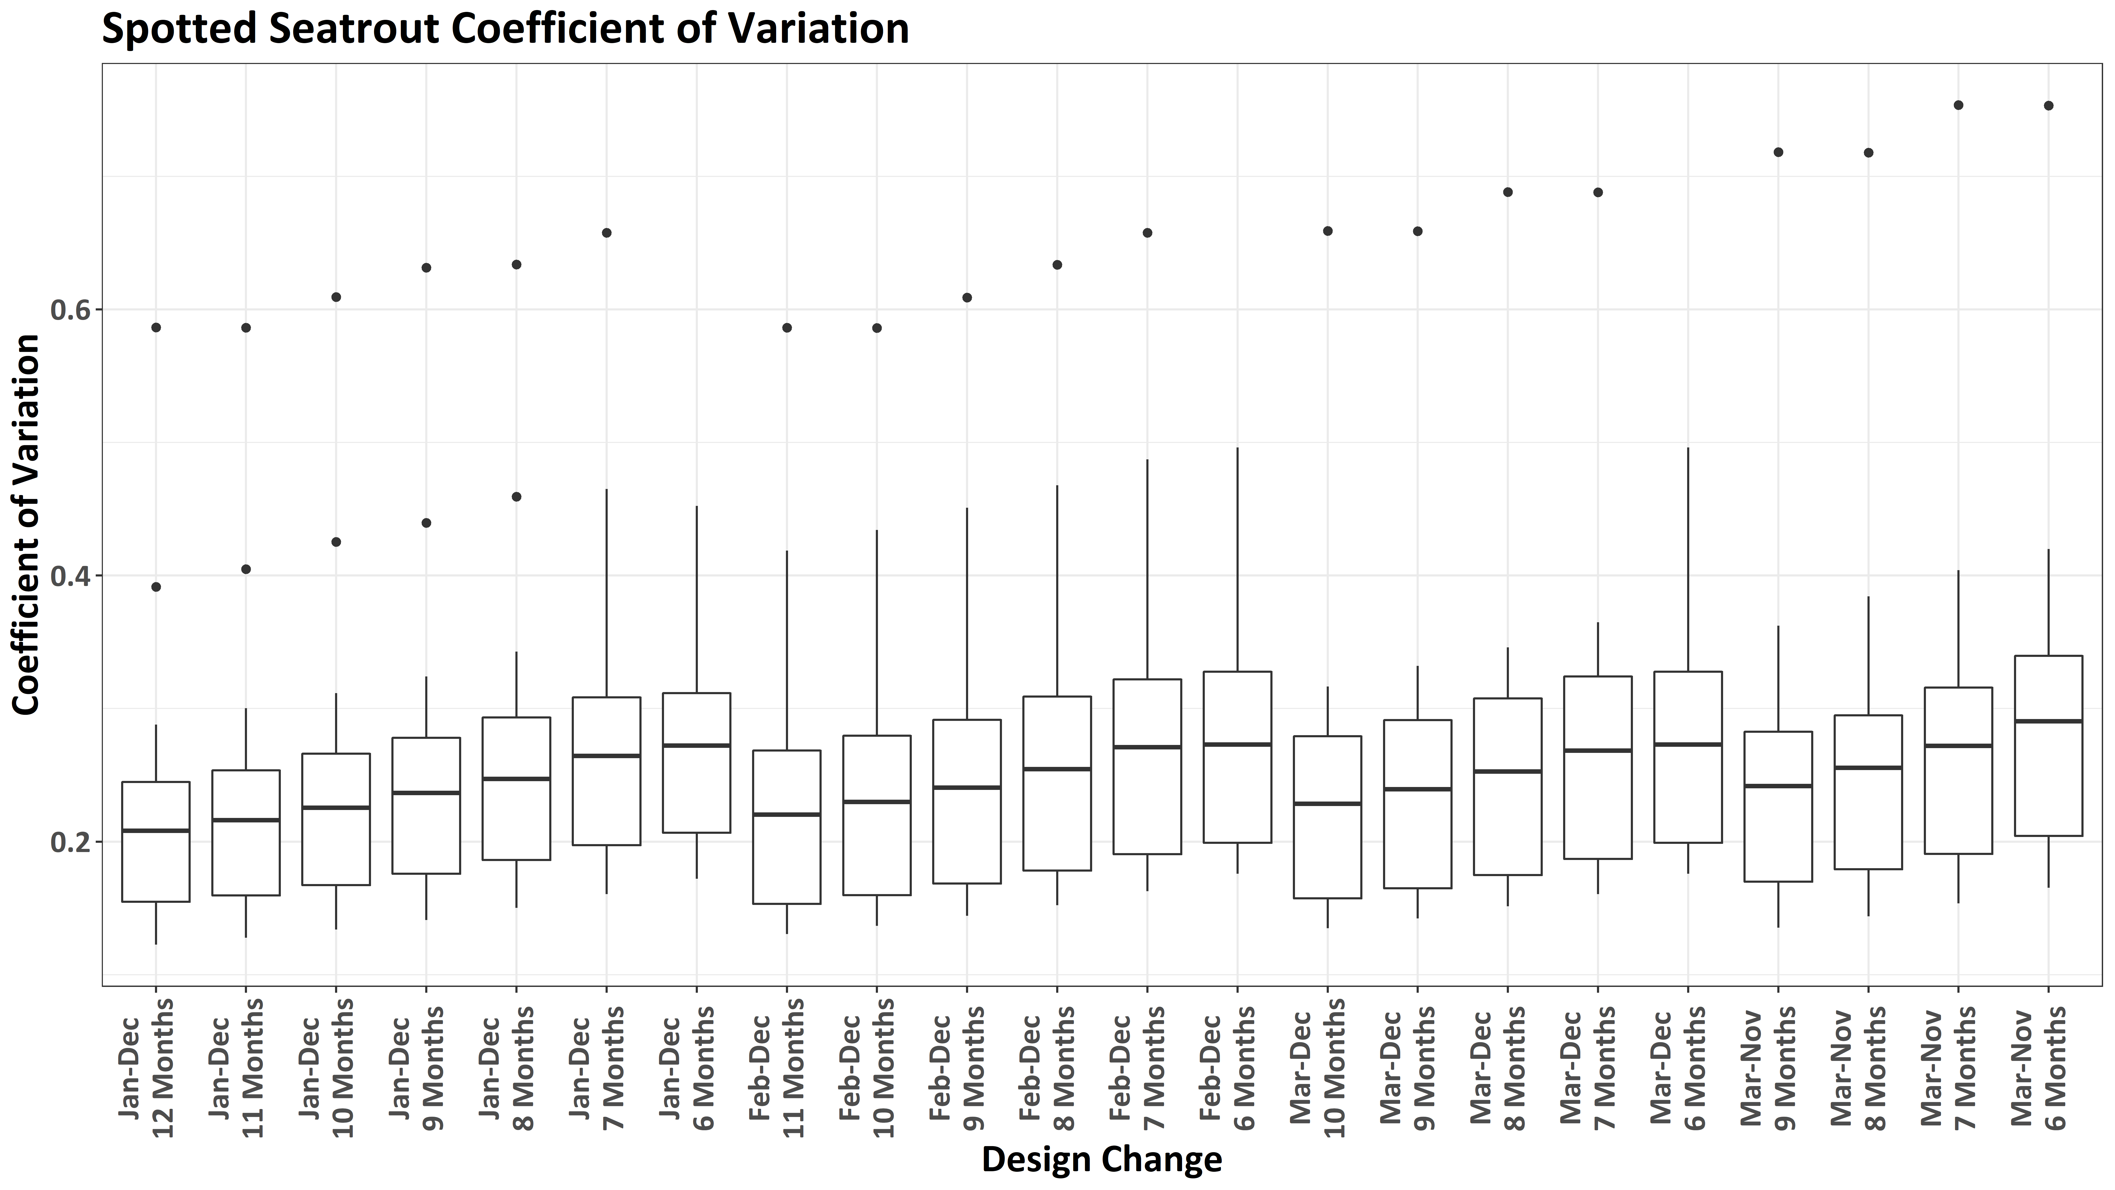
Notes:
The one difference here is that median CVs, regardless of sampling scenario, are all in excess of 0.2. This reflects the relatively rare occurrence of spotted seatrout in the electrofishing survey, as they are only the 18th most common species in the survey.

Slide 68
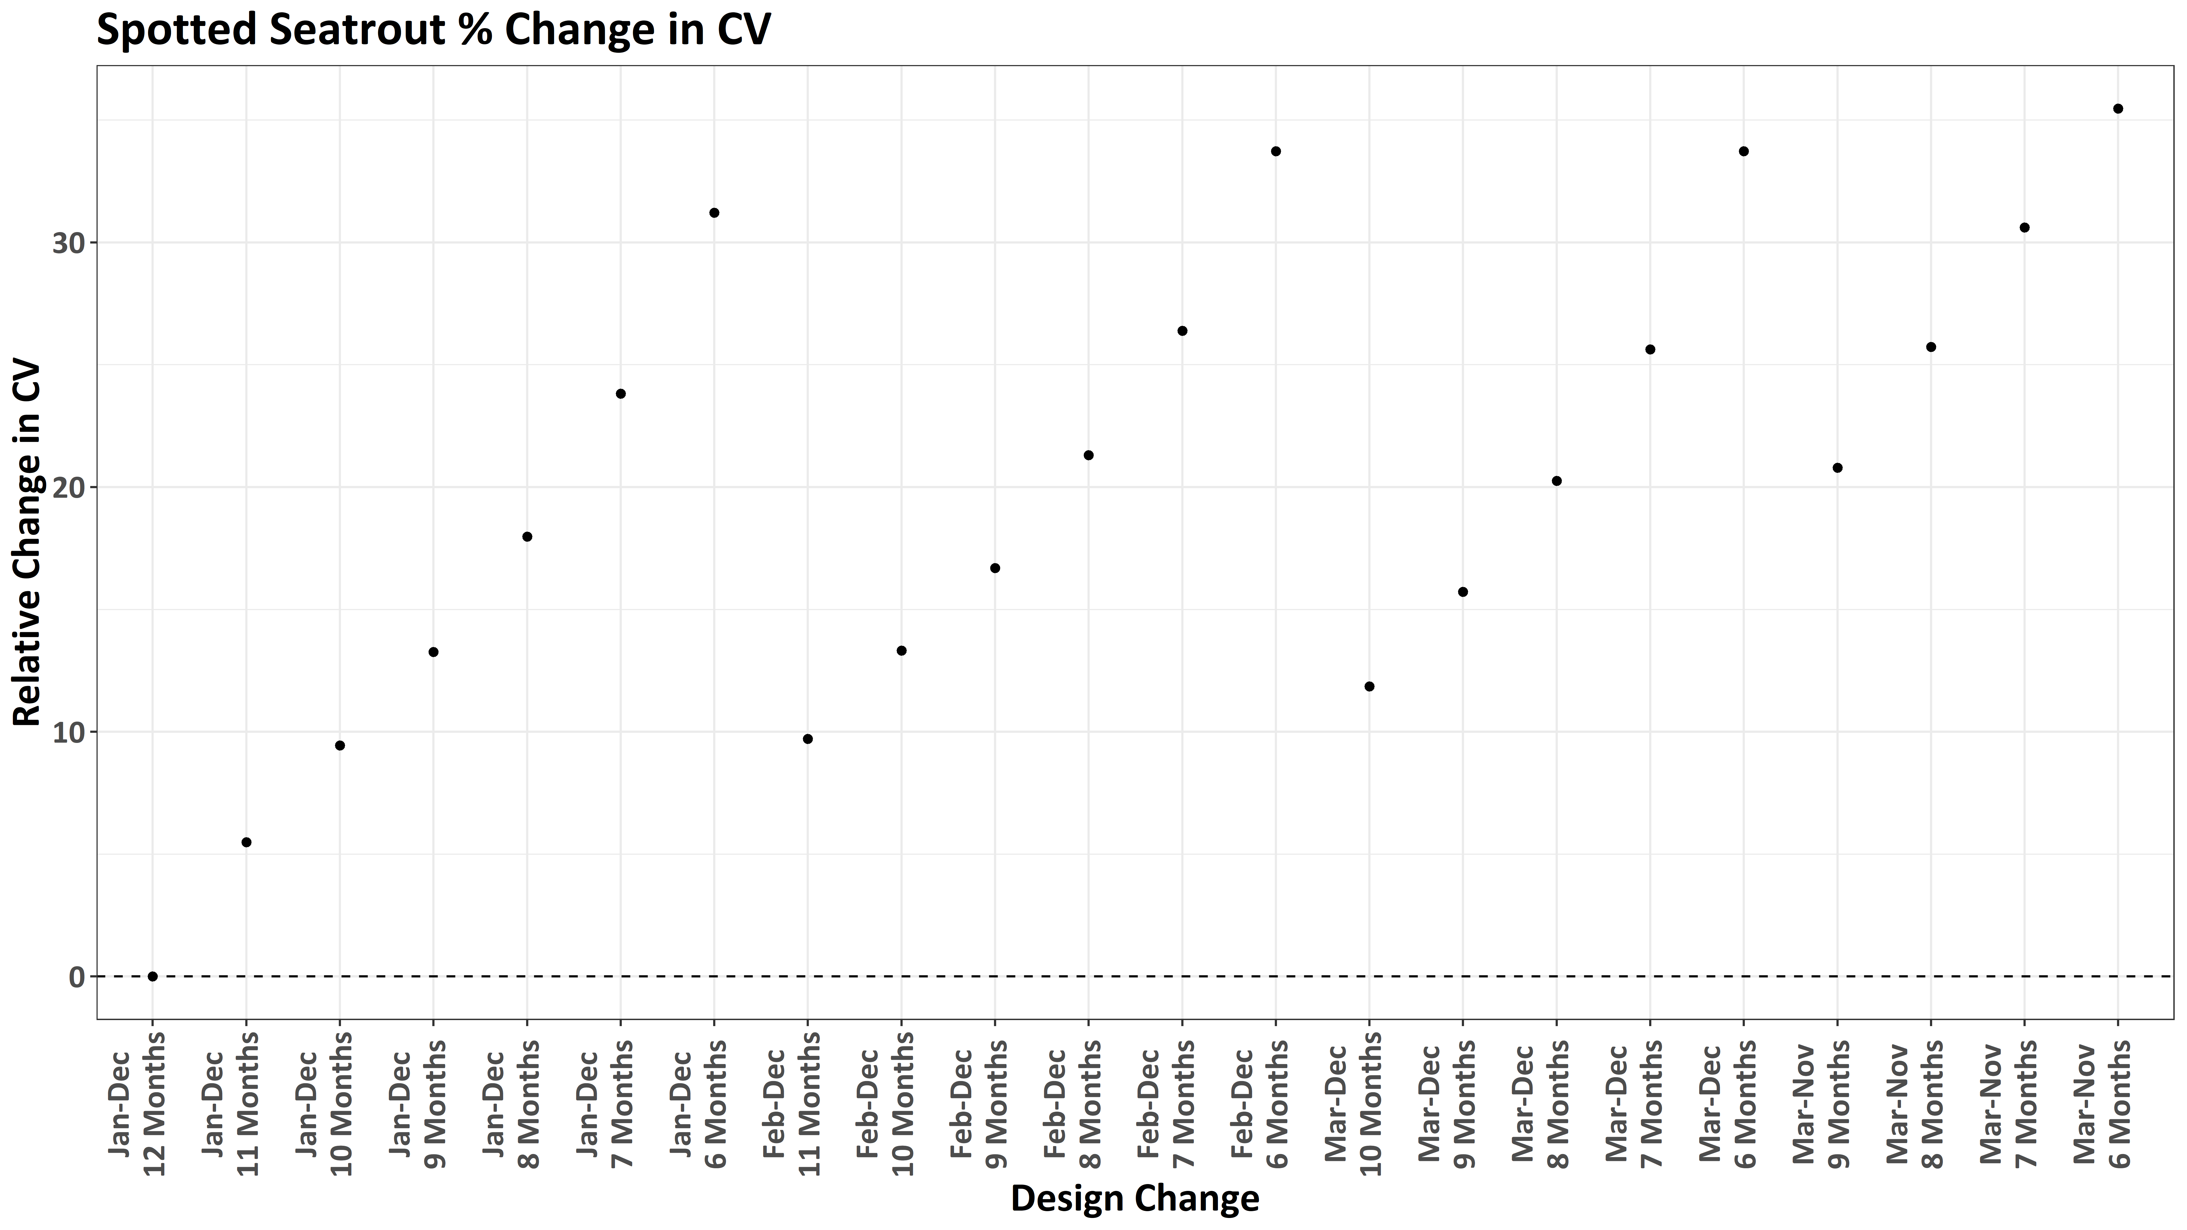
Notes:
Further, spotted seatrout seem to be fairly susceptible to changes in both survey design and sampling frequency with regards to median CV estimates with all design changes allowing for a >20% reduction in sampling effort leads to greater than a 10% increase in median CV.
The best option appears to be maintaining year round sampling, while scaling back sampling frequency to 9 times a year for each strata

Slide 69
How would it have affected our understanding of Striped Bass relative abundance?

Slide 70
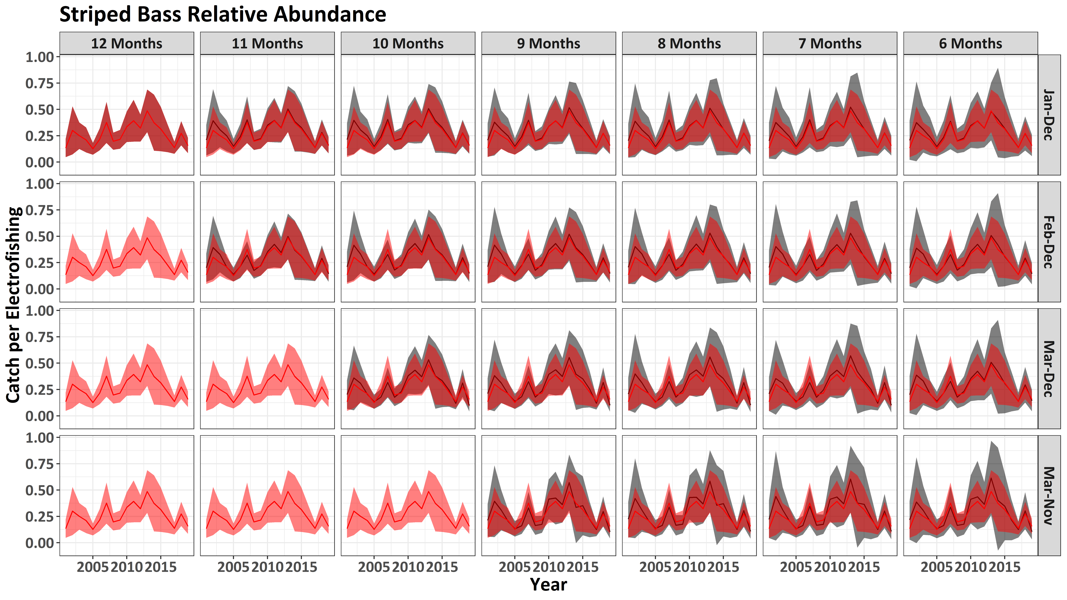
Notes:
Striped bass are a fairly rare occurrence in the electrofishing survey, being the 26th most common species. But even they show relative insensitivity to surve design changes with regards to relative abundance.

Slide 71

Notes:
However, like Spotted Seatrout, median CVs, regardless of sampling scenario, are all in excess of 0.2. This reflects the relatively rare occurrence of striped bass in the electrofishing survey

Slide 72
How do survey design changes affect overall uncertainty across species?

Slide 73
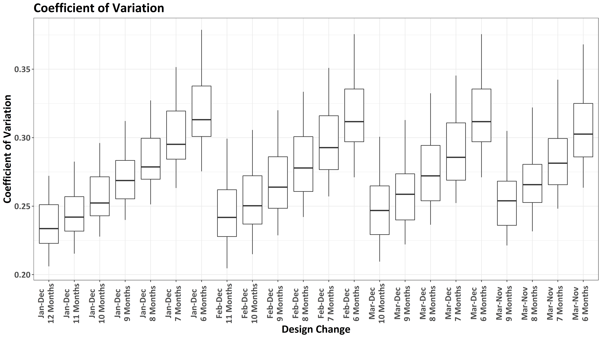
Notes:
When we look at how the median CV changes across all 29 species for which we have averaged catching >50 individuals annually, the lower sampling effort relative to the trammel net survey becomes apparent.

Slide 74
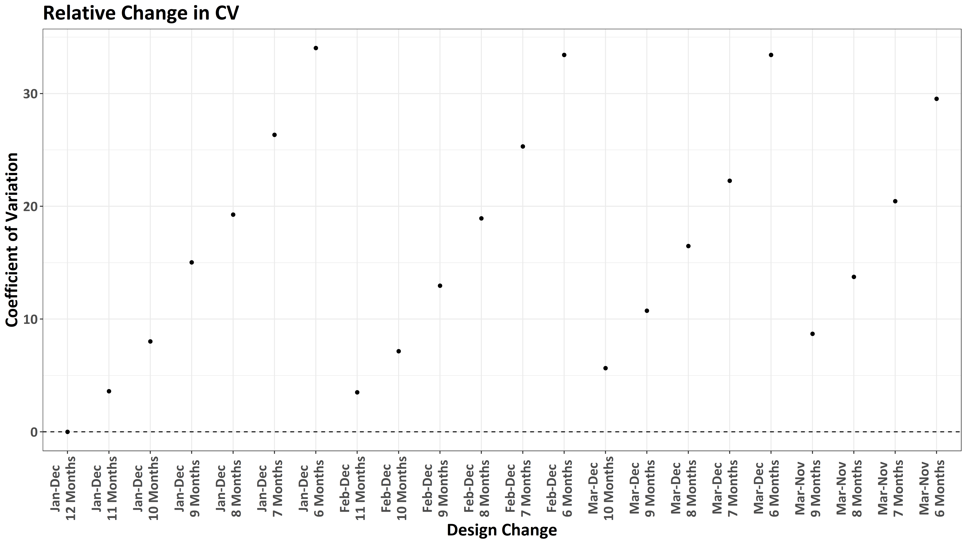
Notes:
However, several scenarios allow for <10% increase in median CV, the most promising of which that allows us to achieve a 20-40% reduction in sampling effort being to reduce the sampling season to March-November and sample every strata monthly during this period

Slide 75
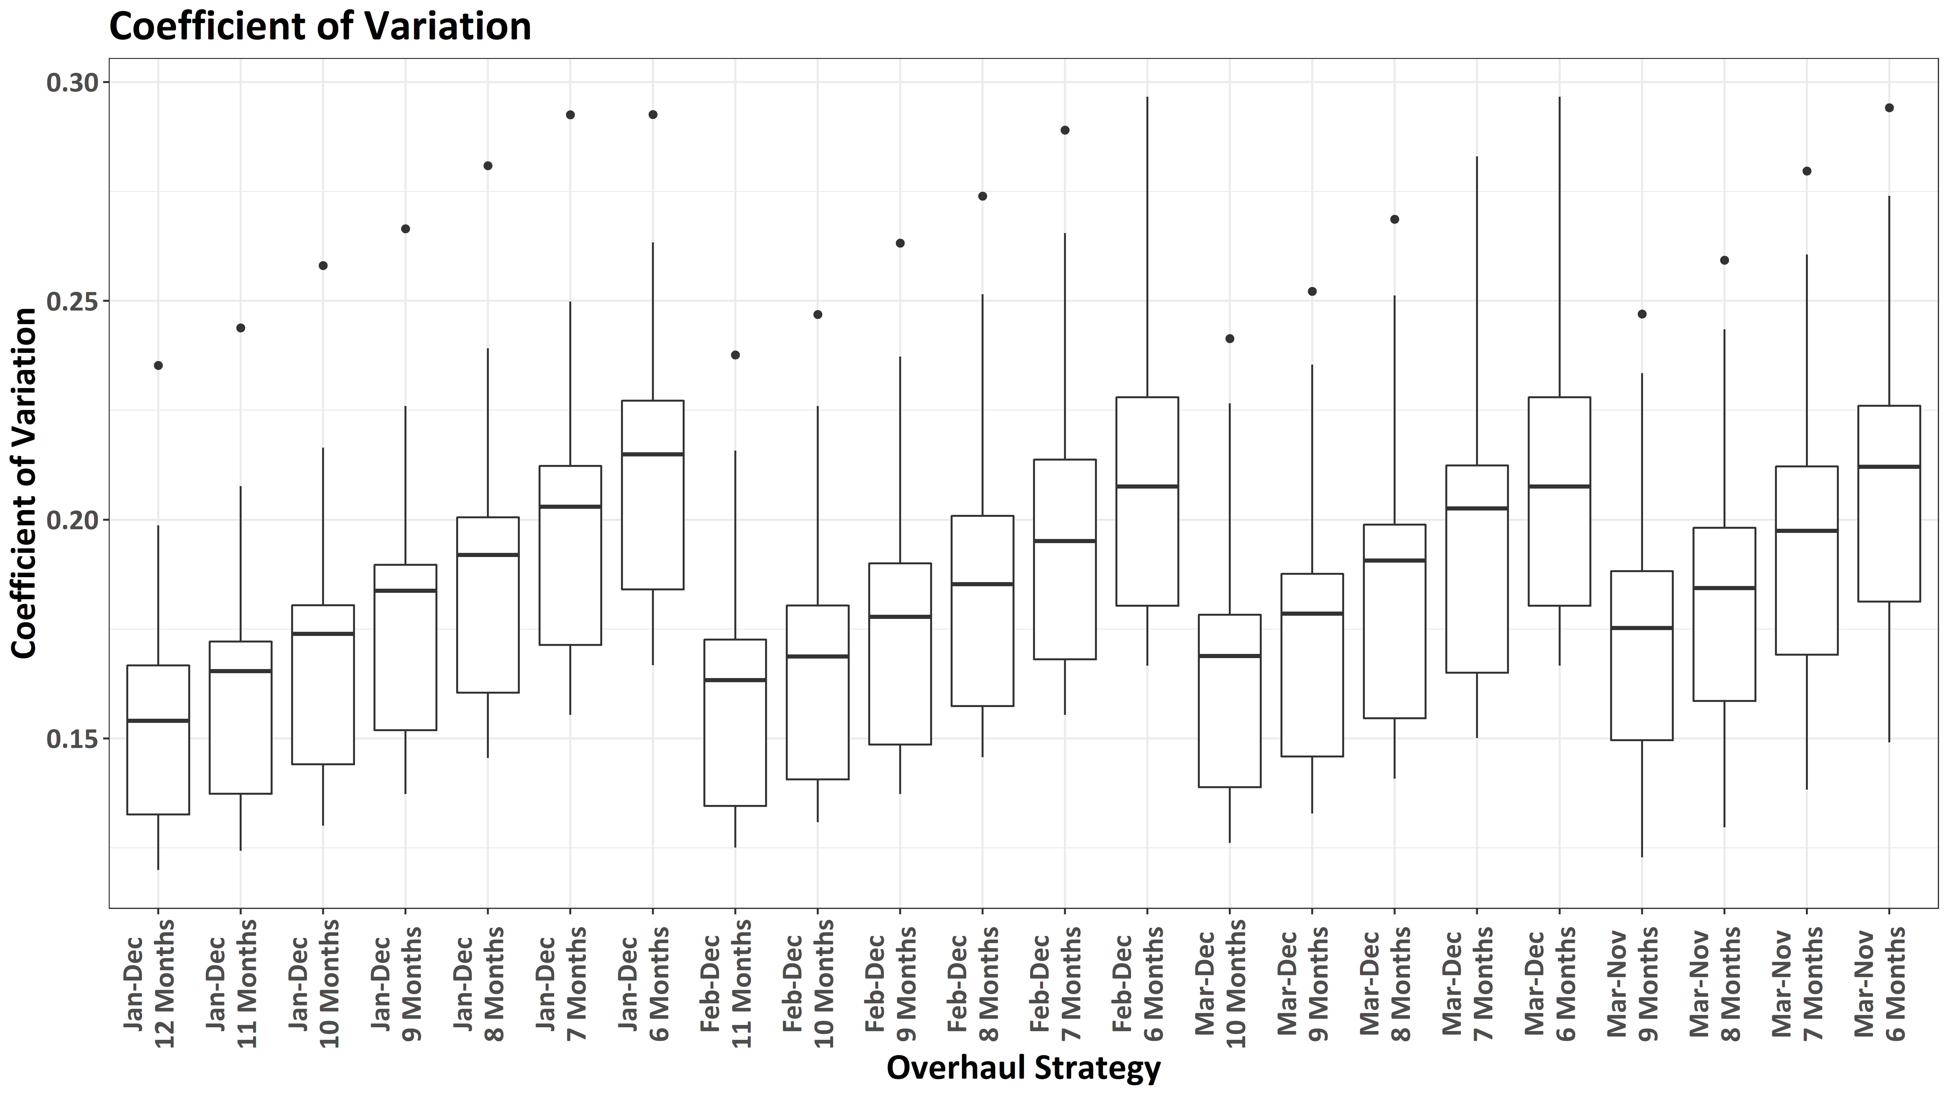
Notes:
We have better success if the goal is to maintain our median CV across select species below the magic 0.2 level. Here, most different survey design changes will allow us to maintain across species CVs below 0.2, while reducing sampling effort.

Slide 76
Conclusions

Slide 77
Possible to get 20-40% reduction in field time without significantly impacting ability to track abundance trends
Trammel Net Survey
Combination of strata definition, sampling season, and sampling frequency modifications likely most effective
Best options
Merge Cape Romain (MB & RH) and Port Royal Sound strata
Cape Romain strata were merged from 1994-1997
Increase sampling frequency in Port Royal Sound
Sample at same frequency as other coastal strata
Modify sampling season to March-November or February – December
Sample each strata 8-10 times annually

Slide 78
Possible to get 20-40% reduction in field time without significantly impacting ability to track abundance trends
Trammel Net Survey
Electrofishing Survey
Less scope for sampling reduction while maintaining quality of data
Best option
Moderate decrease in sampling frequency
9 – 11 sampling events per strata, annually
Either maintain year-round sampling or move to March-November sampling

Slide 79
Questions?

Slide 80
My Recommendation
Trammel Net
Merge strata
Port Royal Sound – One boat sample traditional Colleton River strata, one boat sample traditional Broad River strata
Cape Romain – one boat sample traditional McClellanville Banks strata; one boat sample traditional Romain Harbor strata
Establish March – November field season
If miss month due to weather, boat issues, etc, makeup in other non-sampled months
Target sampling each strata 9 times annually
Obtain an approximate 33% reduction in sampling effort

Slide 81
My Recommendation
Trammel Net
Electrofishing
Maintain year-round sampling season
Target a sampling frequency of 10 times annually for each strata
Obtains an approximate 17% reduction in field time

Slide 82
My Recommendation
Trammel Net
Electrofishing
In combination, this results in a reduction of ~30% of activities related to the surveys annually – 2.5 staff positions
Trammel Net Survey Reduction
33% reduction in field time – 4.6 vs 6.9 full time staff required
Electrofishing Survey Reduction
17% reduction in field time – 1.8 vs 2.2 full time staff required

Slide 83
Extra Slides

Slide 84
How have these surveys been funded?
SRFAC, RecFIN, SEAMAP-SA, Interjurisdictional Funds, COASTSPAN,

Slide 85
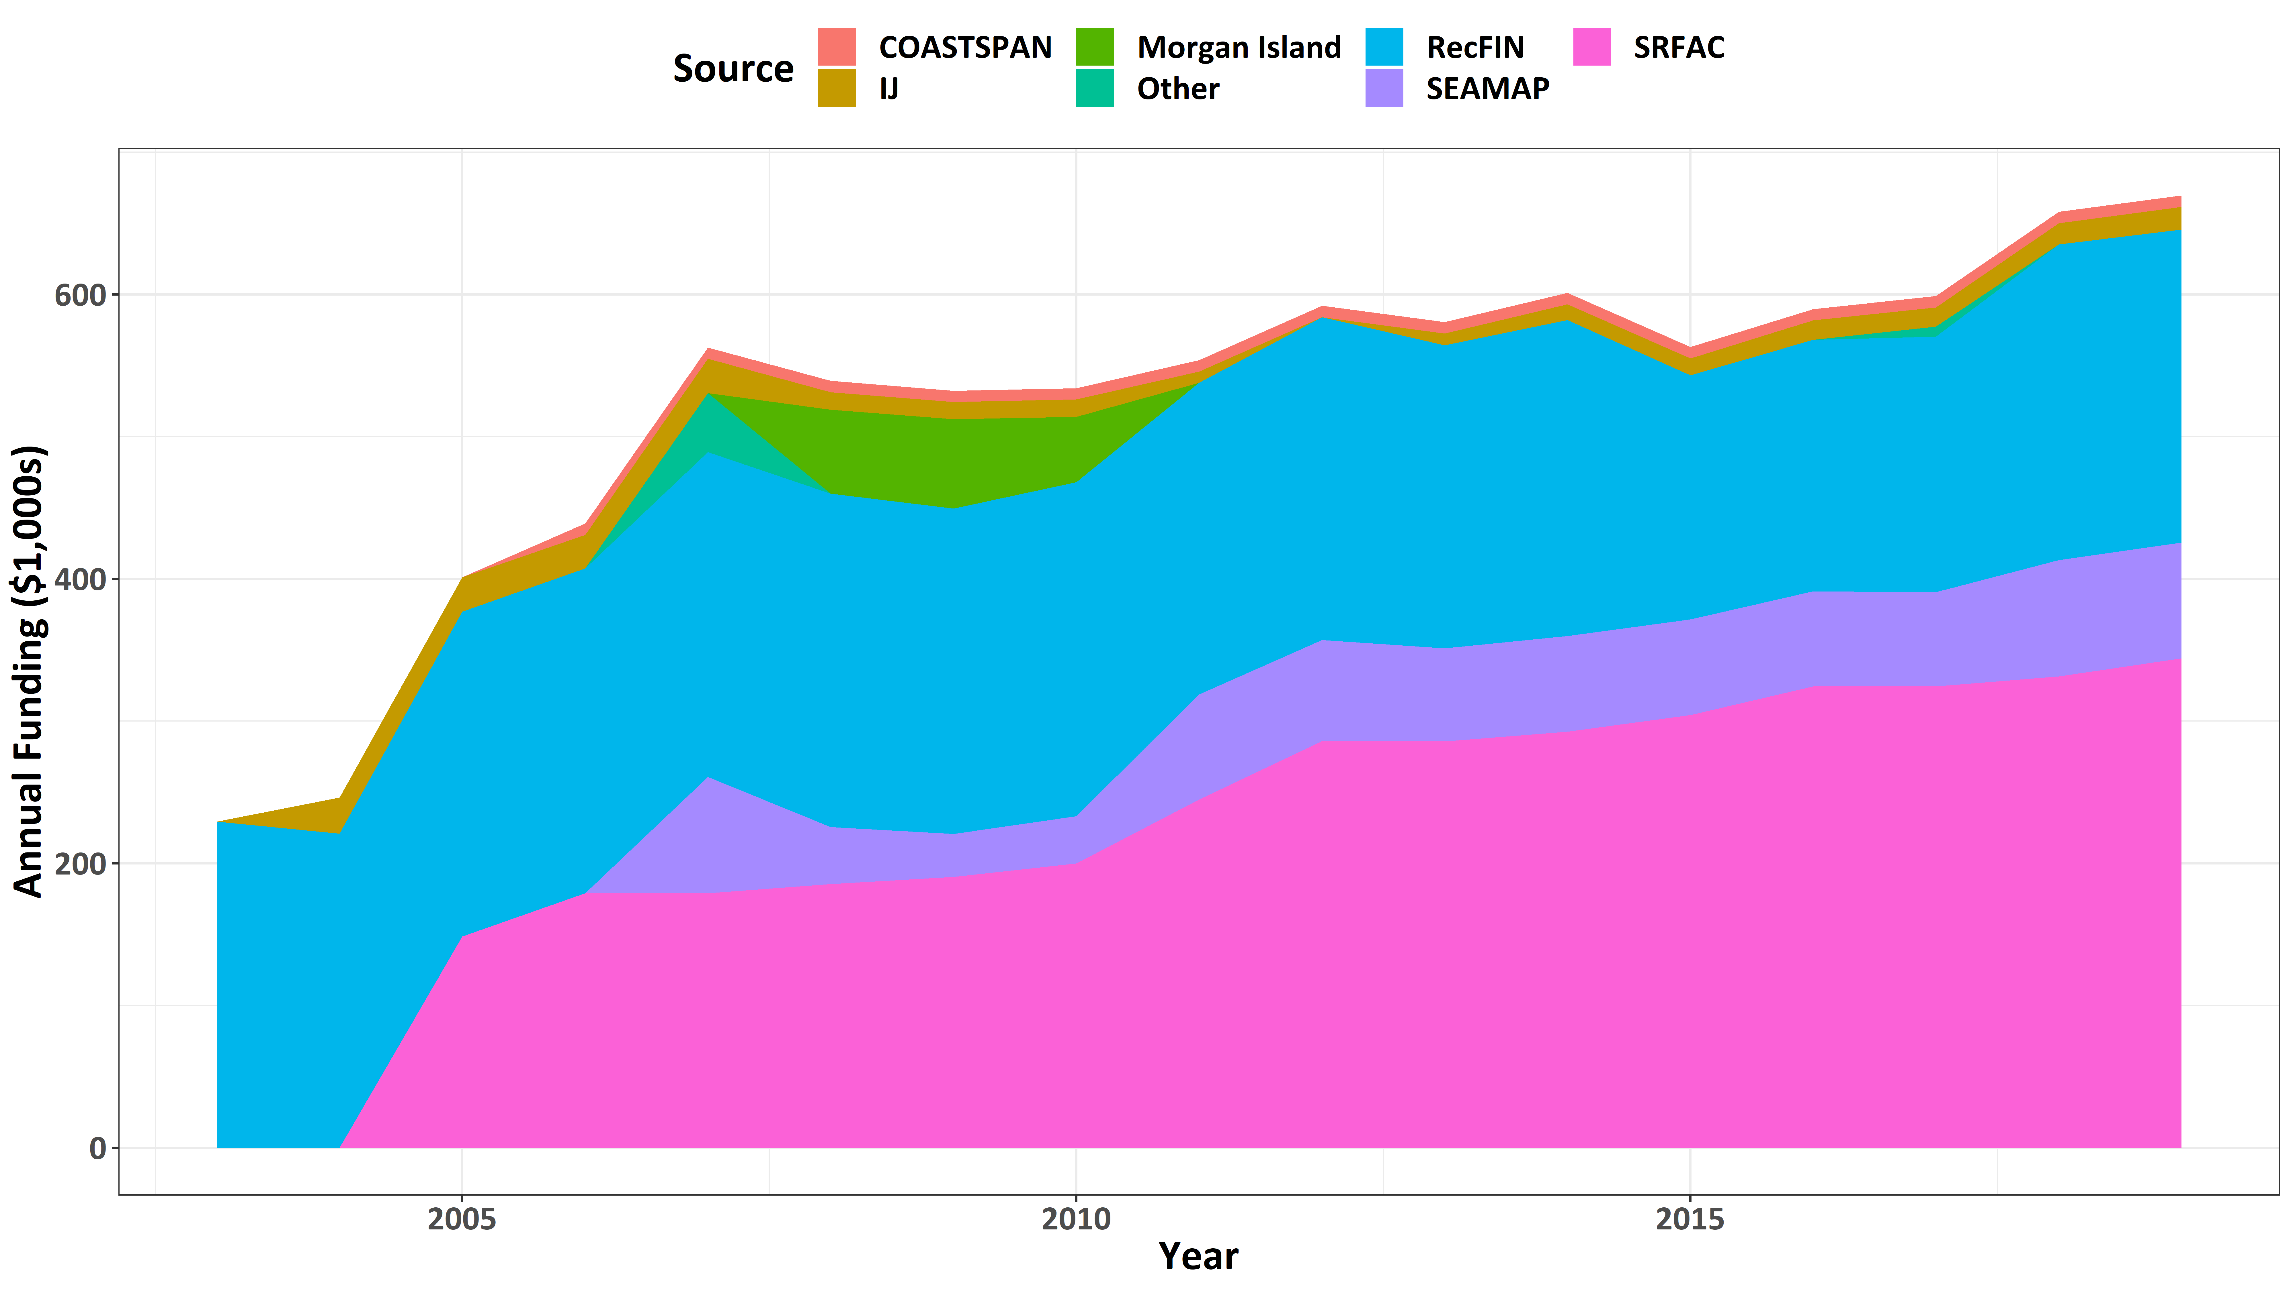
Notes:
Despite the importance of these fishery-independent surveys, if you look at our core funding sources, those being SRFAC, Recfin, SEAMAP, IJ, and COASTSPAN, with some funds made available from Morgan Island Funds and other funding sources during years with declines in other funding sources, you will notice that from…

Slide 86
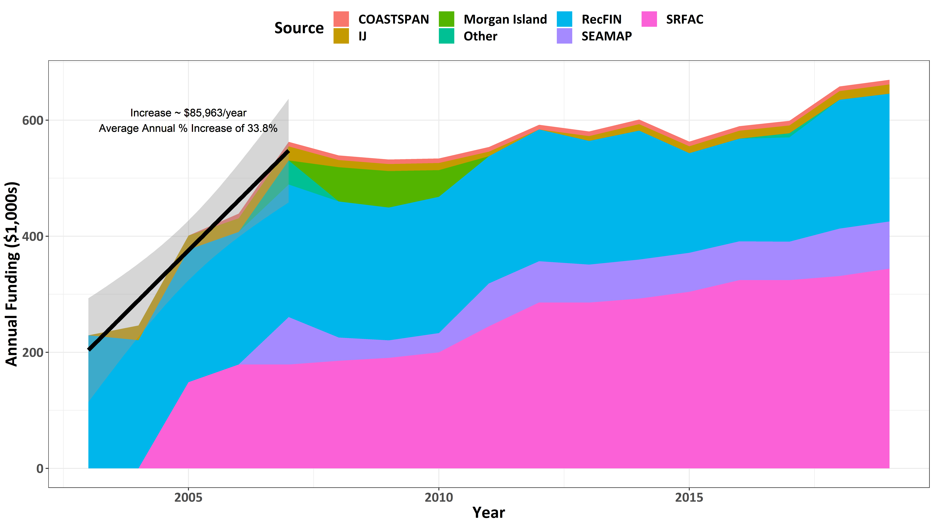
Notes:
2003-2007 funding steadily increased, at a rate of about $86k per year, which equates to an average increase of ~33.8% over the 5 year period

Slide 87
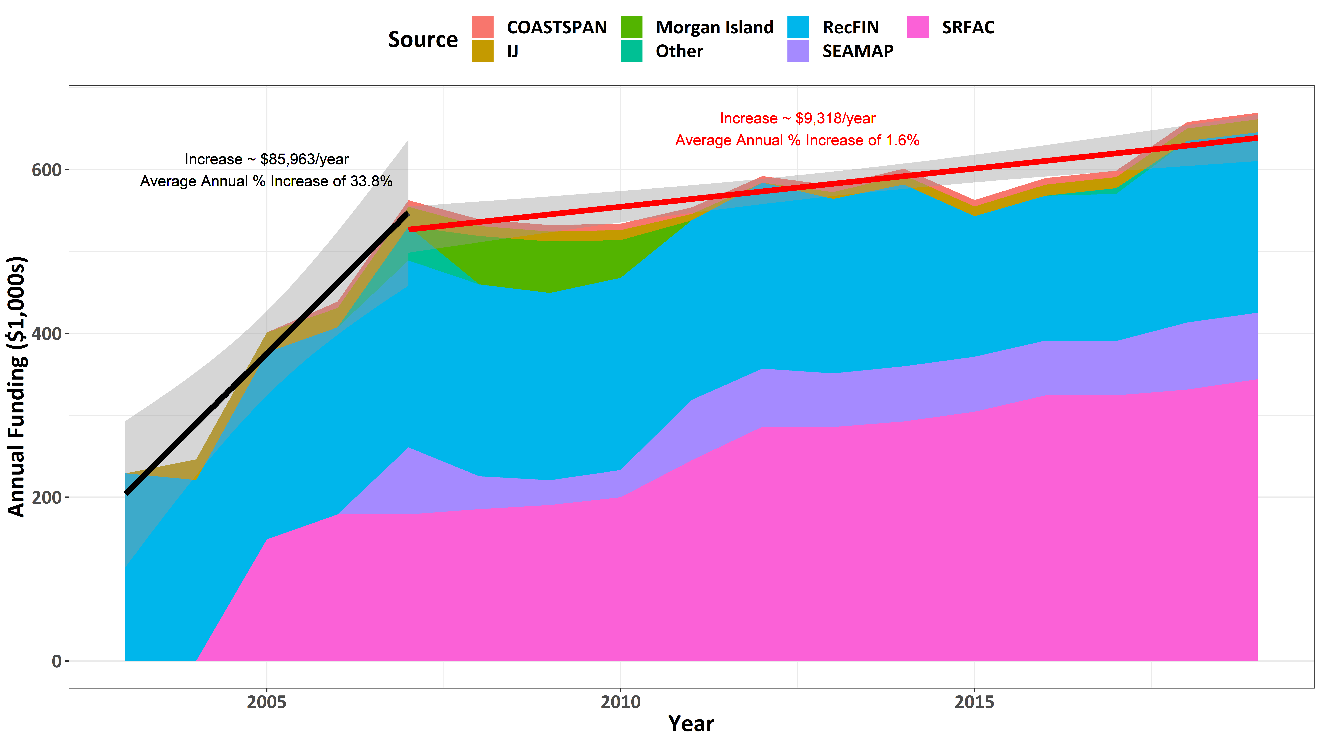
Consumer Prices increased ~1.7% per year
Source: Bureau of Labor Statistics Consumer Price Index
Salary increased ~2-5% per year
Total annual cost increase ~ 3.7-6.7% per year
Shortage of ~1.1-4.1% per year since 2007
Notes:
However, beginning in 2007, and through 2019, the rate of increase in core funds slowed dramatically, such that the annual increase was only about $9k per year. This equates to an average annual increase of ~1.6% annually over the last 13 years or about a 20% increase relative to 2019 total.
At the same time, consumer prices have increased at about ~1.7% per year…
and salaries have increased at about 2-5% per year.
This equates to an average overall cost increase of 4-7% per year. This means, annually we have seen a shortage of ~1-4% per year since 2007 with regards to increasing funds for these surveys, or a total deficit in funds of 14-53% as of today.

Slide 88
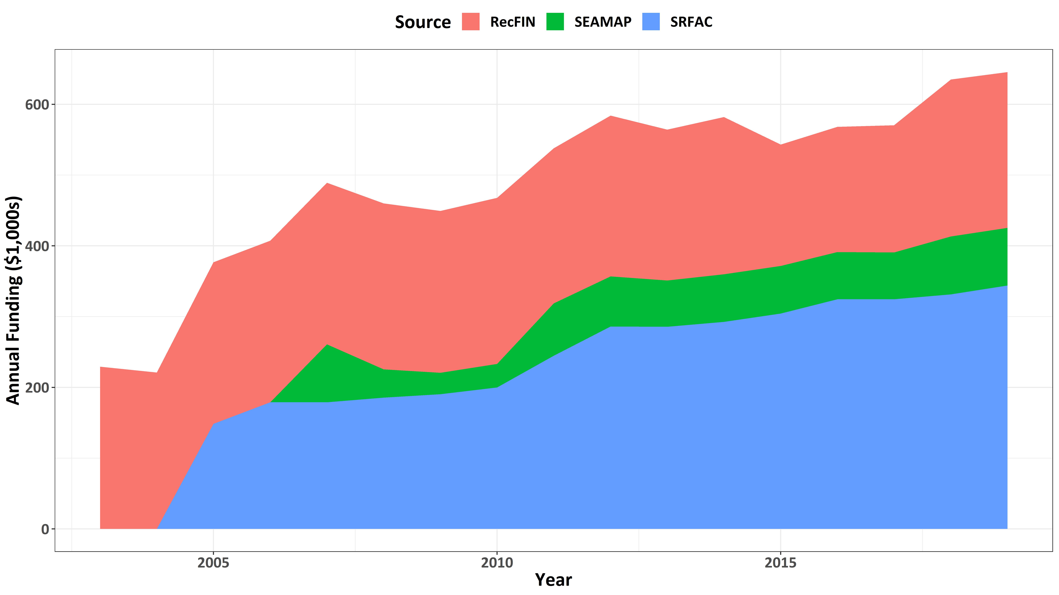
Notes:
If you look at just the increase in our three main funding sources, RecFIN, SEAMAP, and SRFAC, the increase from….

Slide 89
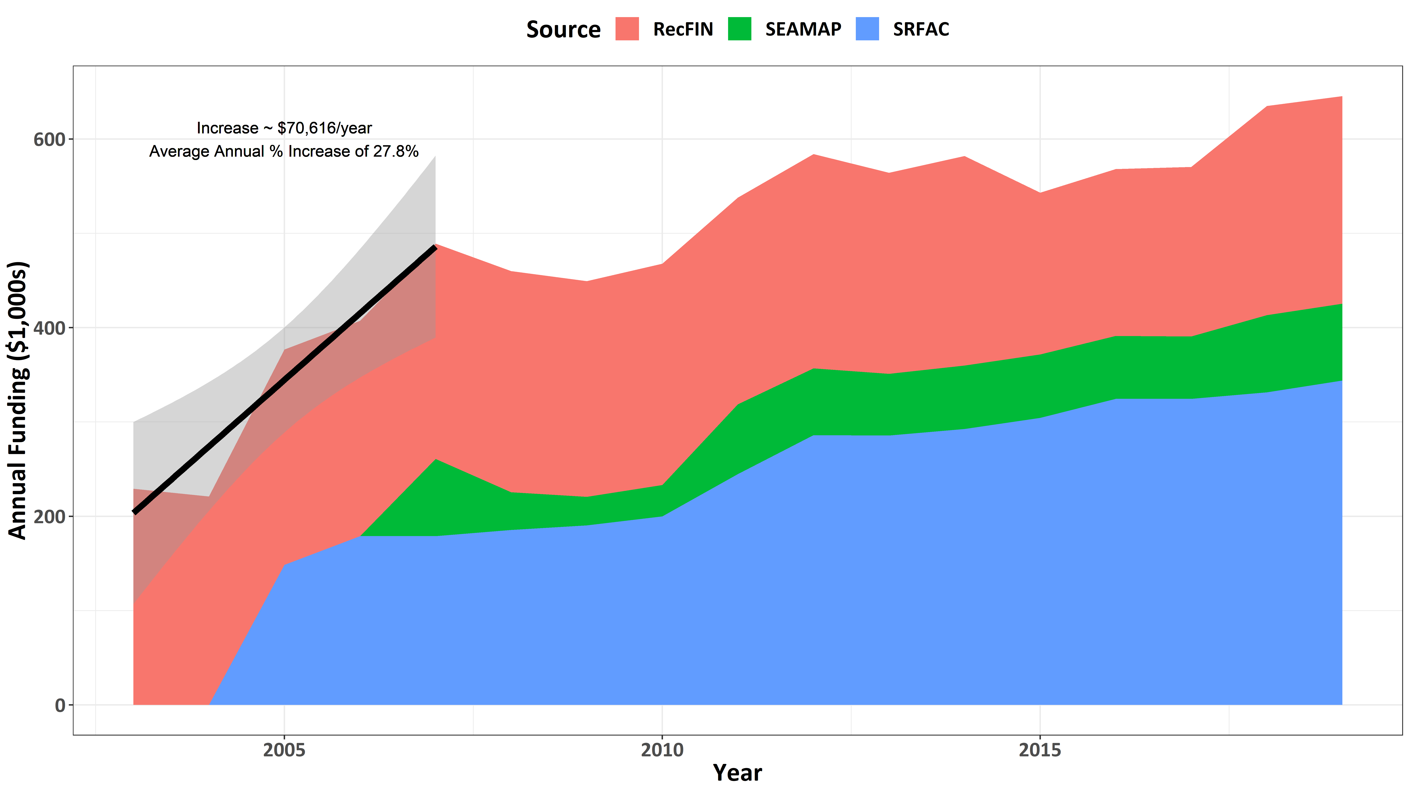
Notes:
2003-2007 funding steadily increased, at a rate of about $71k per year, which equates to an average increase of ~27.8% over the 5 year period

Slide 90
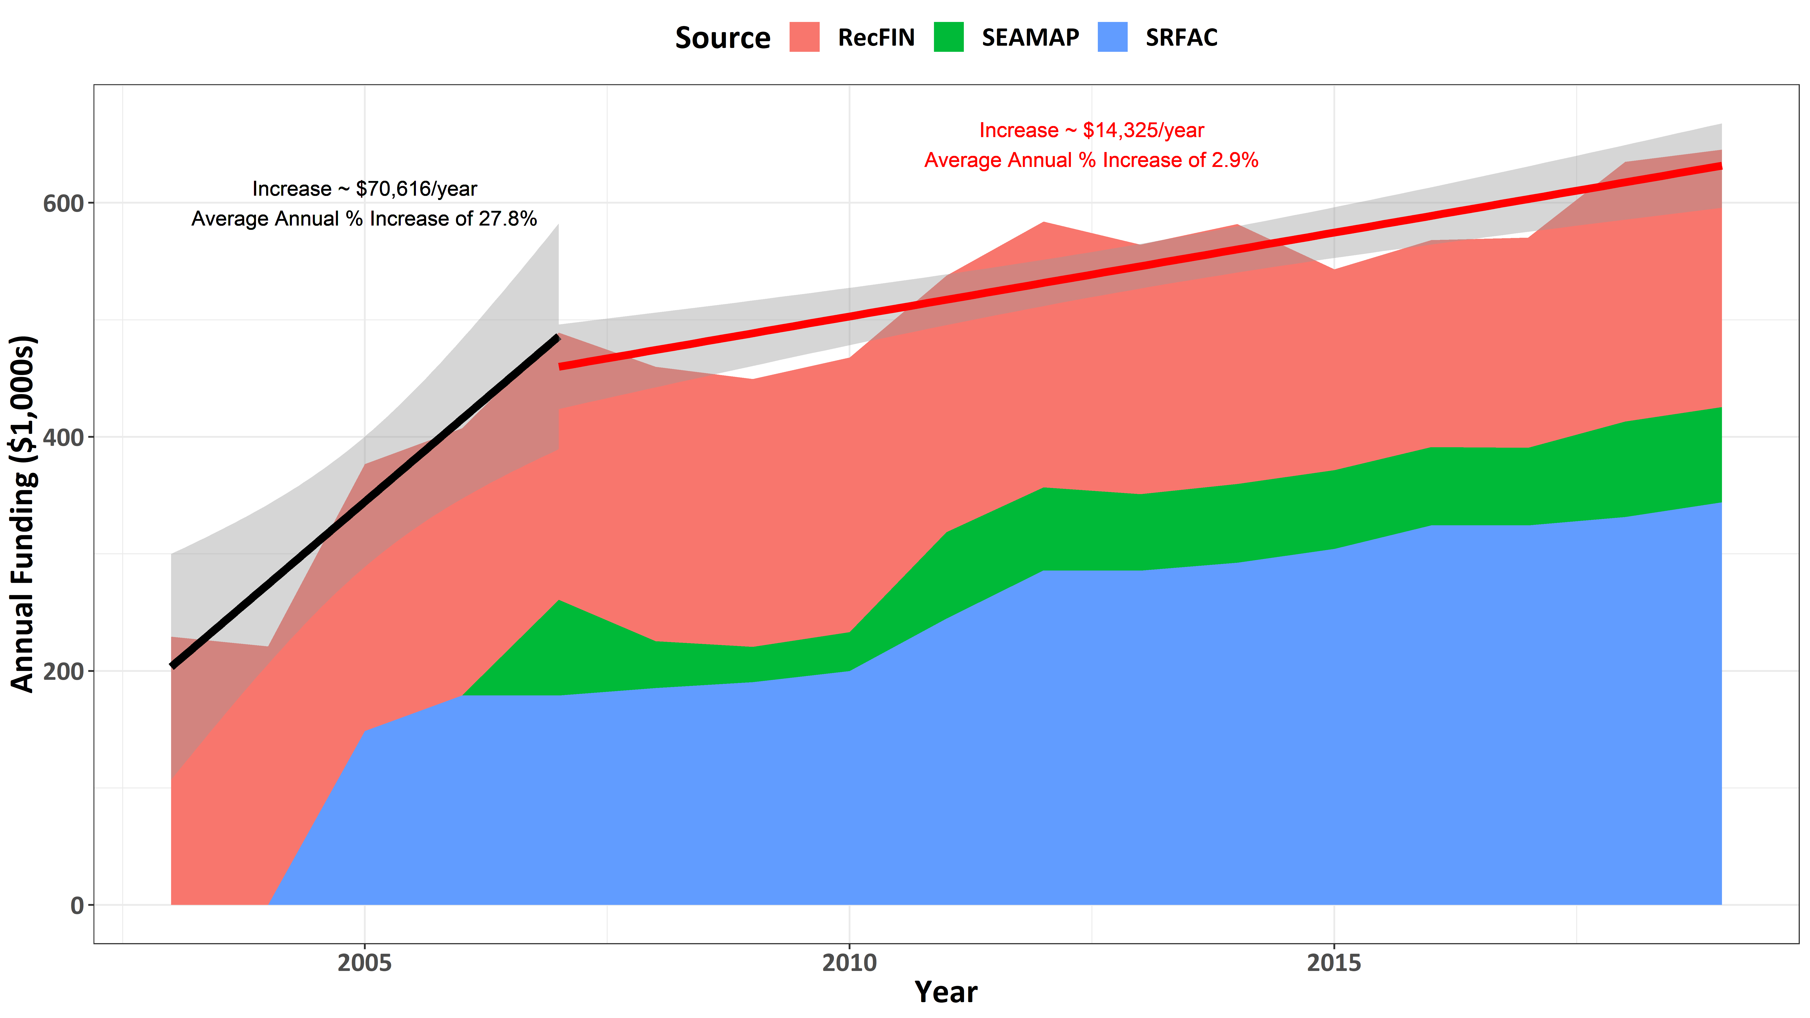
Consumer Prices increased ~1.7% per year
Source: Bureau of Labor Statistics Consumer Price Index
Salary increased ~2-5% per year
Total annual cost increase ~ 3.7-6.7% per year
Shortage of ~0.8-3.8% per year since 2007
Notes:
From 2007 through 2019, the rate of increase in core funds slowed dramatically, such that the annual increase was only about $14k per year. This equates to an average annual increase of ~2.9% annually over the last 13 years or about 37.7% over the last 13 years.
At the same time, consumer prices have increased at about ~1.7% per year and salaries have increased at about 2-5% per year. This equates to an average overall cost increase of 3.7-6.7% per year. This means, annually we have seen a shortage of ~1.1-4.1% per year since 2007 with regards to increasing funds for these surveys, or a total deficit in funds of 10-49% as of today.

Slide 91
How has sampling effort changed in the Trammel Net and Electrofishing Surveys?
Notes:
Now let’s look at how over the same period, 2007-2019, sampling effort has changed in the trammel net and electrofishing surveys

Slide 92
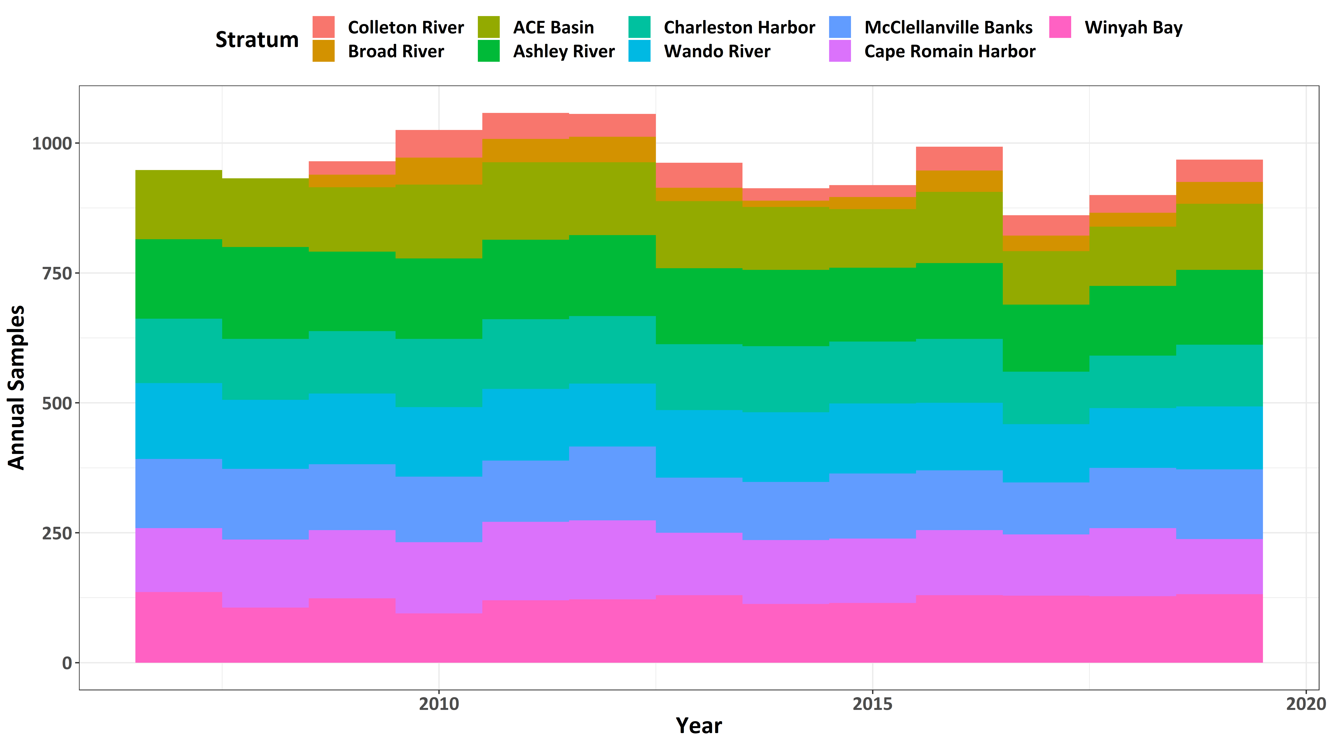
Notes:
We will first look at the number of trammel net collections per year.
What you notice when you look at the number of trammel collections over the same period is there isn’t a decrease in the number of annual collections.

Slide 93
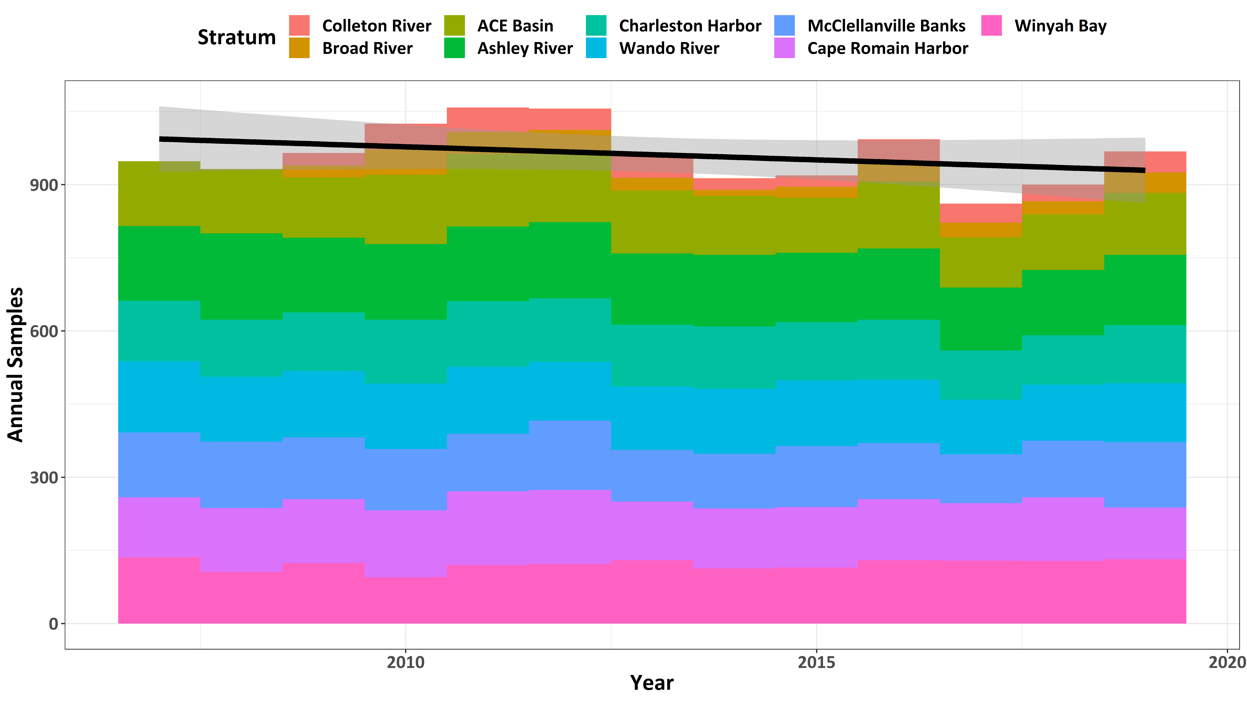
Notes:
And when we put a trend to it, there is no indication of a decline in annual sampling over the period.
The only real difference is that whereas we sample most strata monthly, resulting in ~120 samples per year in monthly sampled strata, we only get about a 1/3 of the number of collections from our Port Royal strata due to quarterly sampling.

Slide 94
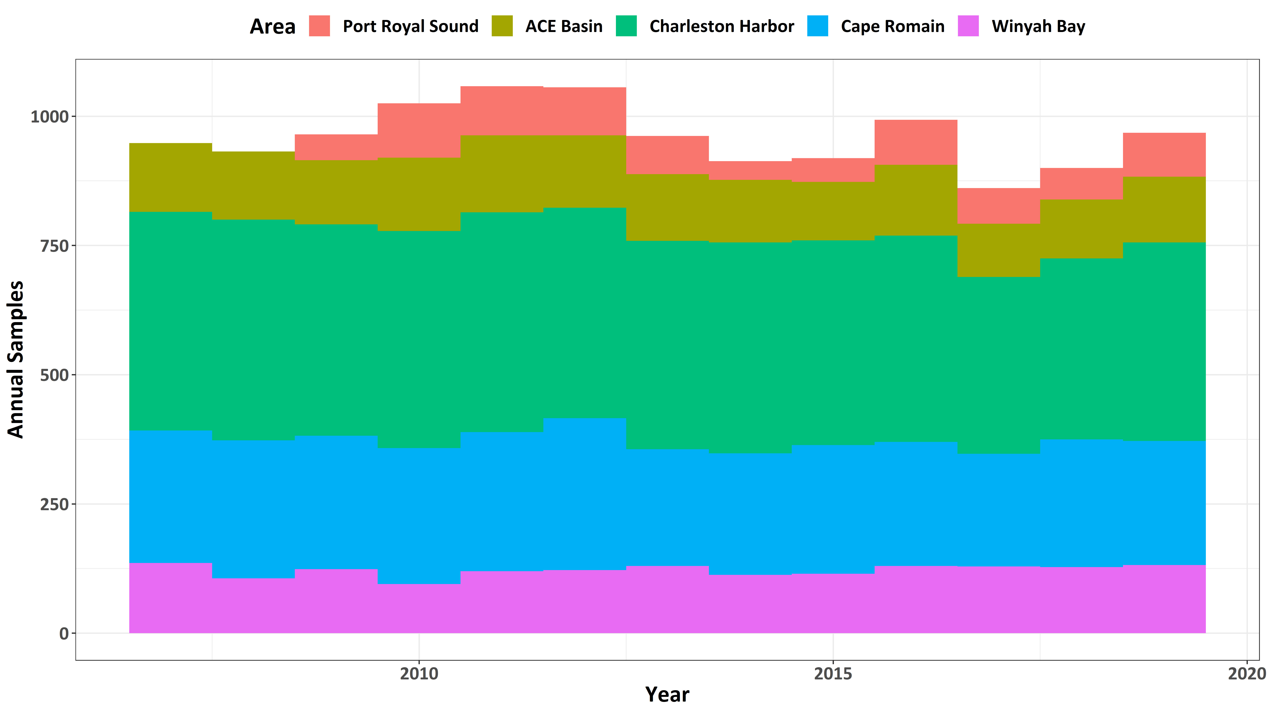
Notes:
Further, when we look at the number of collections by estuary, we see how we put more emphasis currently on sampling the Charleston Harbor, and Cape Romain areas, and much less emphasis on sampling the Port Royal Sound area. This is because we have 3 strata and 2 strata sampled monthly in these areas respectively, while we only sample the 2 Port Royal Sound strata quarterly.

Slide 95
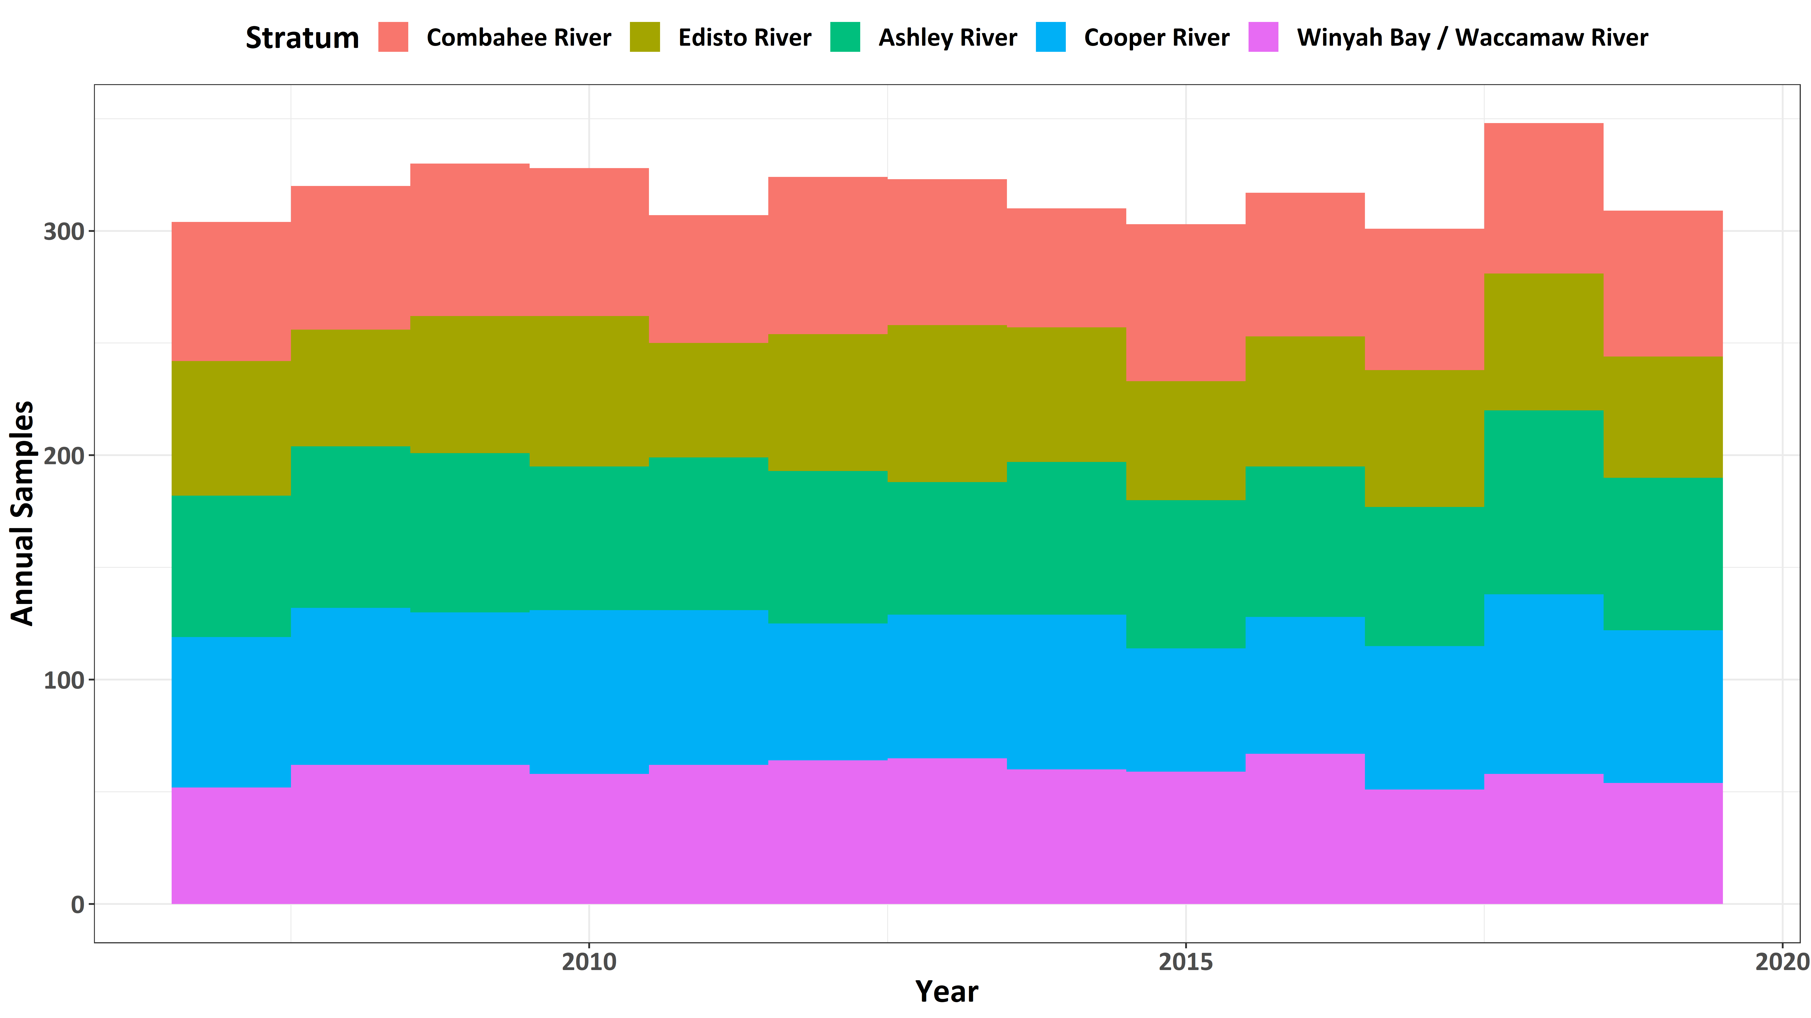
Notes:
With regards to the electrofishing survey, annual sampling has been even more consistent, with…

Slide 96
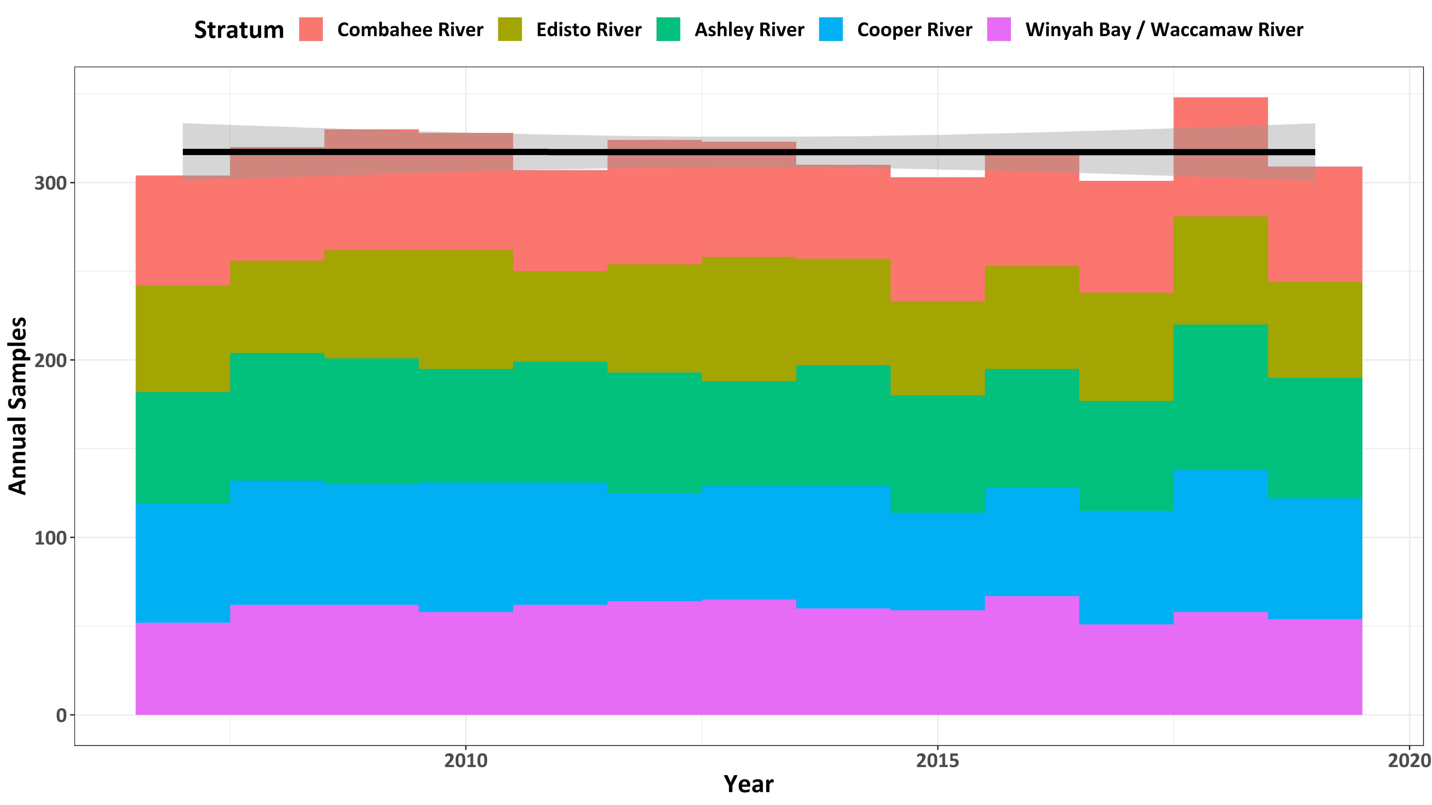
Notes:
Absolutely no decline in annual sampling effort from 2007-2019

Slide 97
Something Must Change!!!
With core funding not increasing at the rate of costs, staff are asked to be…
More efficient
Field work comprises most of the annual staff time in the section
This leads too…
Increased staff burn out
Less time for science = less publications = less competitive for funding
Problem has been growing for many years!!!
Masked by successfully acquiring grant funds
Often comes with additional field tasks, and always requires additional lab/office work
Efficiency has it’s limits
Current - ~$221k shortfall in core funds to support full Inshore staffing needs
Currently we have 3-4 fewer staff than had just 3 years ago

Slide 98
Solution?
Drastic increase in core funding
RecFIN / SEAMAP / IJ / COASTSPAN funds unlikely to increase substantially
Limited scope for increase in state appropriated funds (SRFAC)
Survey Overhaul
Funds = capacity = reduction in field efforts

